Slide 1
THG Simulations
Project update
Weeks 1&2
01/08/2023
David Amorim

Slide 2
First steps
Created (private) project GitHub
Restructured code and updated output plots
Fixed errors in original version:
Hankel aperture radius should be 250µm, not 1mm
Intensity plots in old code plot 133nm instead of 266nm
(see next slide)
Despite of changes, old runs could be reproduced (see Sync&Share)

Slide 3
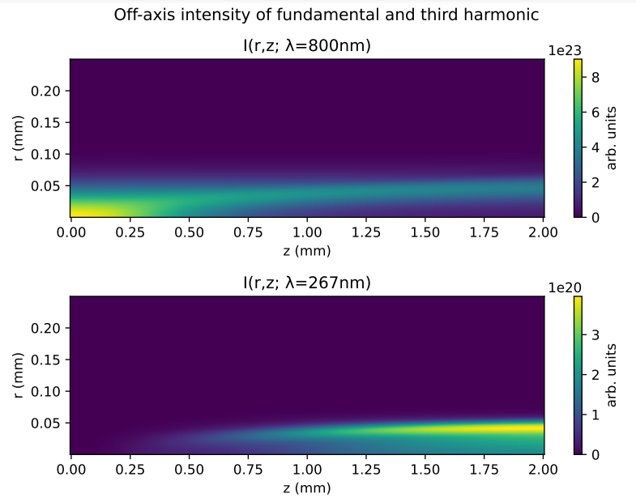
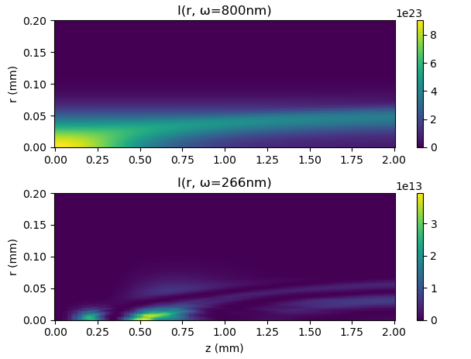
Fixed: error in intensity plots
new code

Slide 4
New features
Three new core features were added:
Option to base input pulse on measured time-intensity data
Tested with IR FROG data from Sync&Share
Option to overlay measured UV pulse for comparison
Tested with UV spectra from Sync&Share
Option to base gas density profile on measured/simulated density data
Untested due to lack of data: get COMSOL files

Slide 5
New features: notes
So far, the input beam is still modelled as a Gaussian in space
spatial profile could easily be based on measured data, too, if necessary
CEO phase of measured input beam was set to zero
replace with measured value?
Measured UV spectrum is rescaled when overlayed, so no quantitative spectral comparison is possible
Due to lack of COMSOL data, there are no runs with the improved density model yet

Slide 6
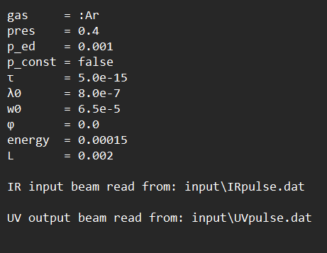
Example run
The following slides show sample output for a run with the parameter values:
Essentially standard settings with gradient approximation for pressure
Raw data from data files on Sync&Share, processed using a Python program called
“file_prepare.py” (also on GitHub)

Slide 7
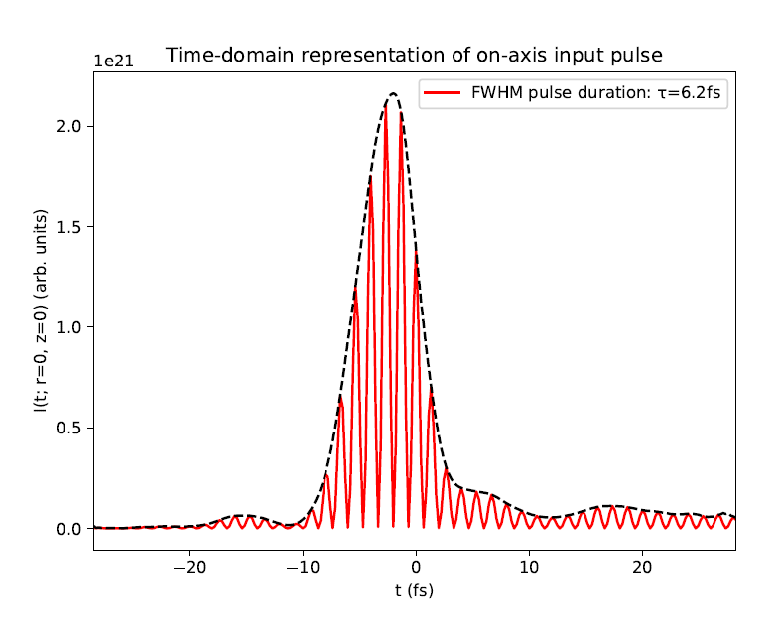
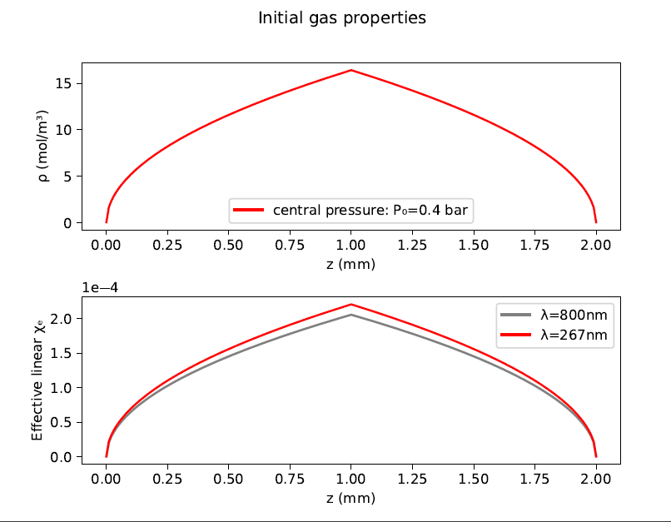
Example run

Slide 8
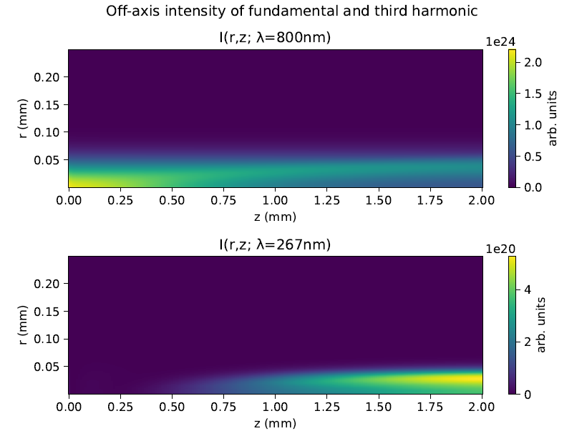
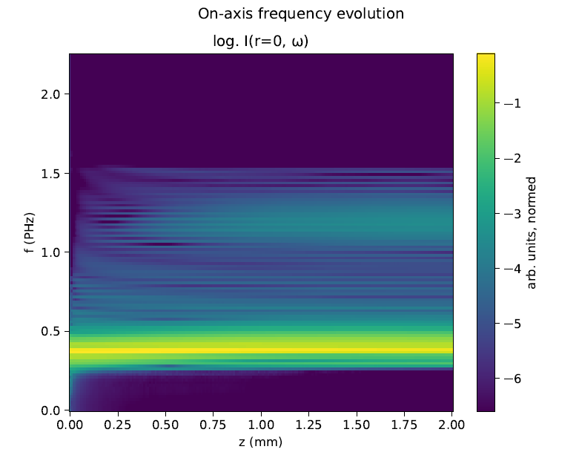
Example run

Slide 9
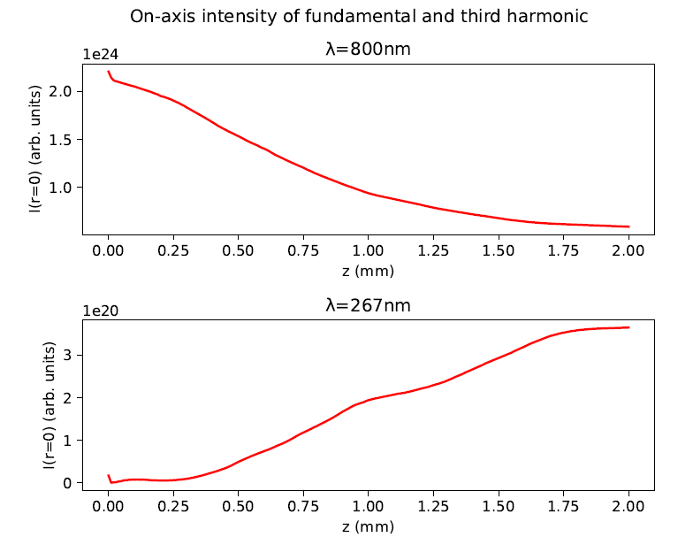
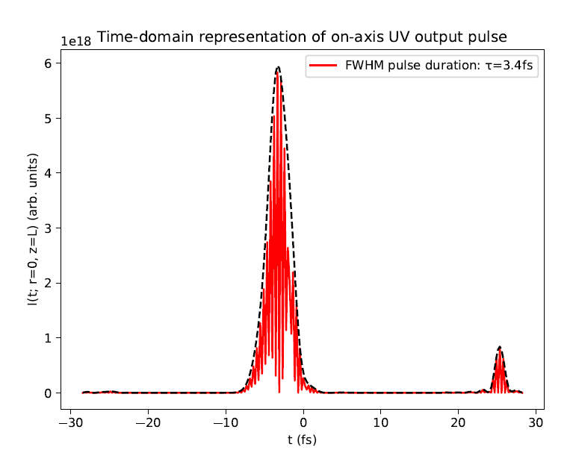
Example run

Slide 10
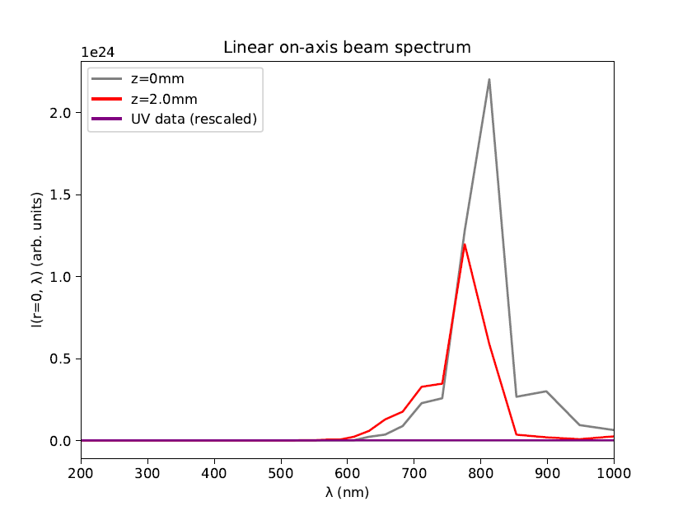
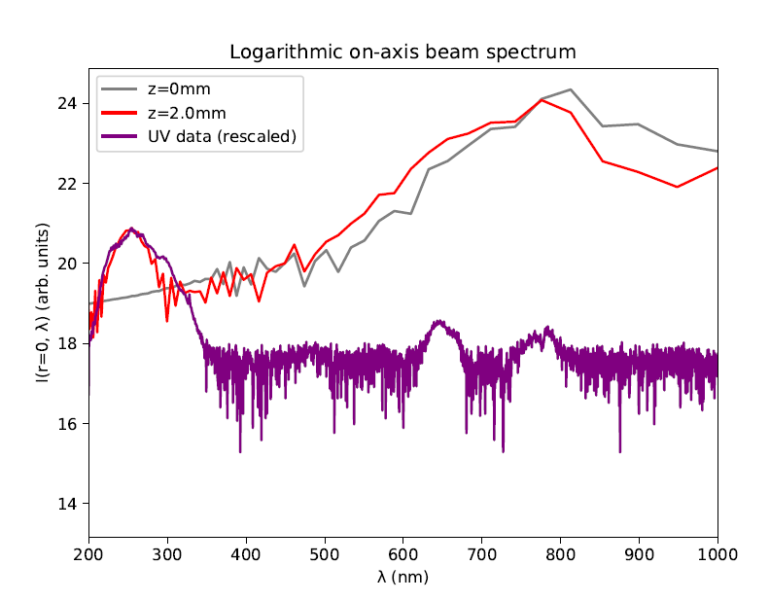
Example run

Slide 11
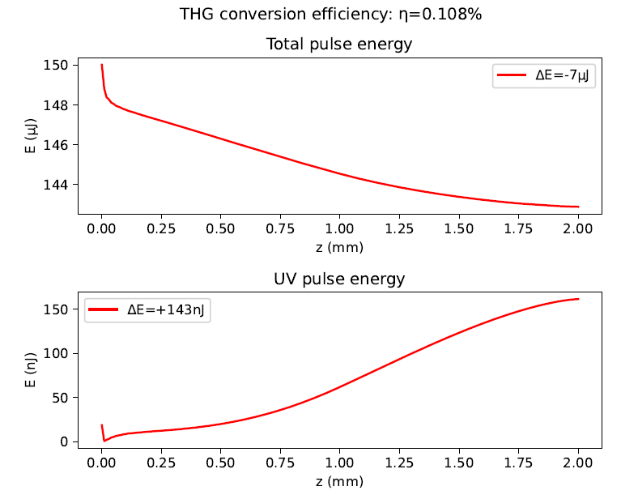
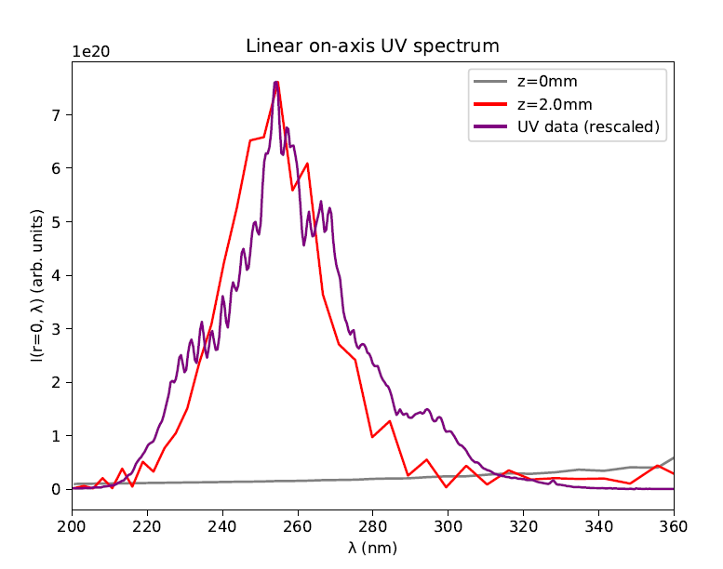
Example run
Measured pulse energy: 110nJ

Slide 12
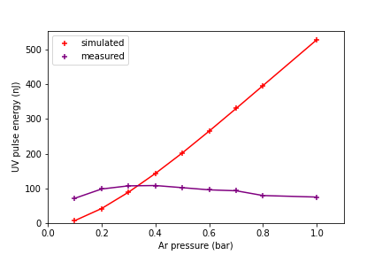
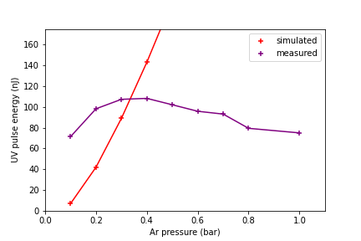
Pressure scan
Ran simulations for Argon and 150mW pulses with pressures ranging from 0.1 bar to 1.0 bar:
No saturation observed in simulations
[zoomed]

Slide 13
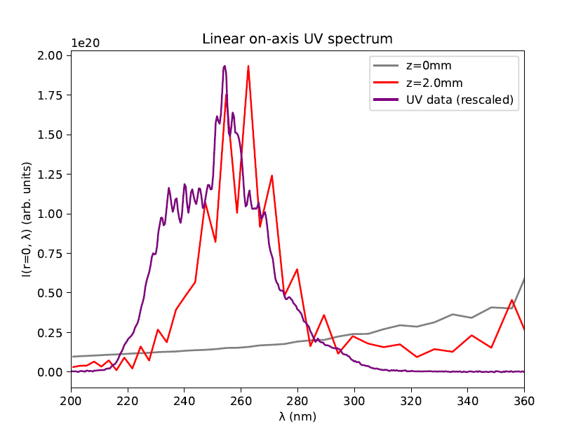
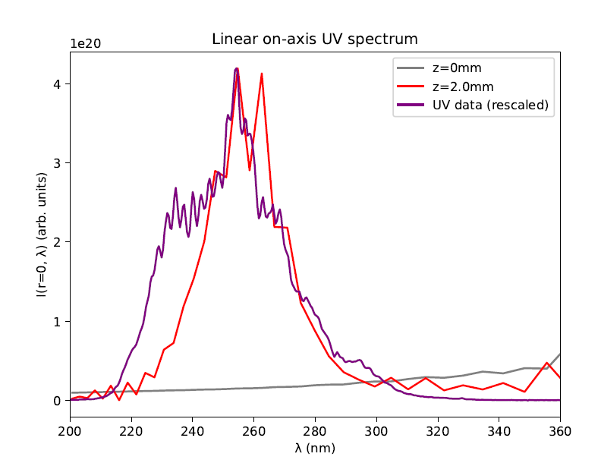
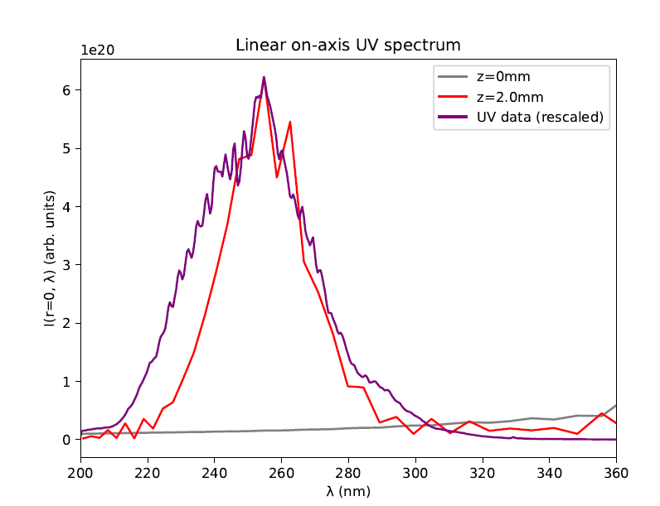
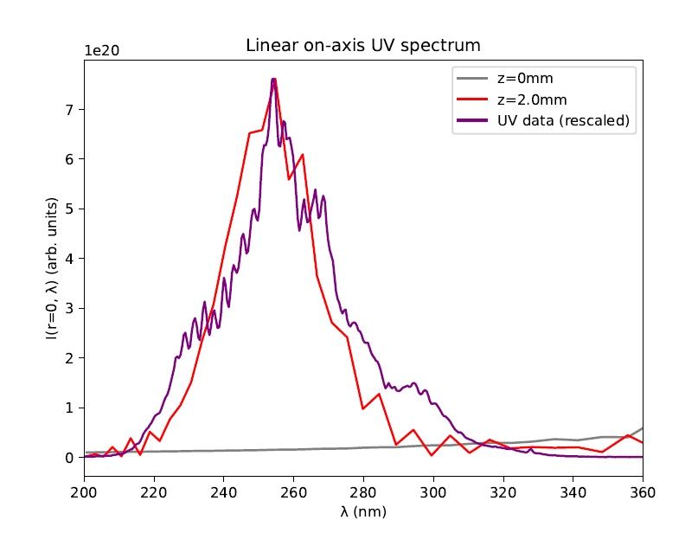
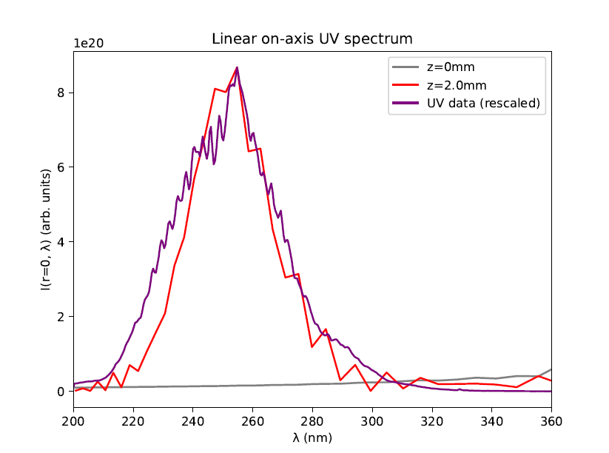
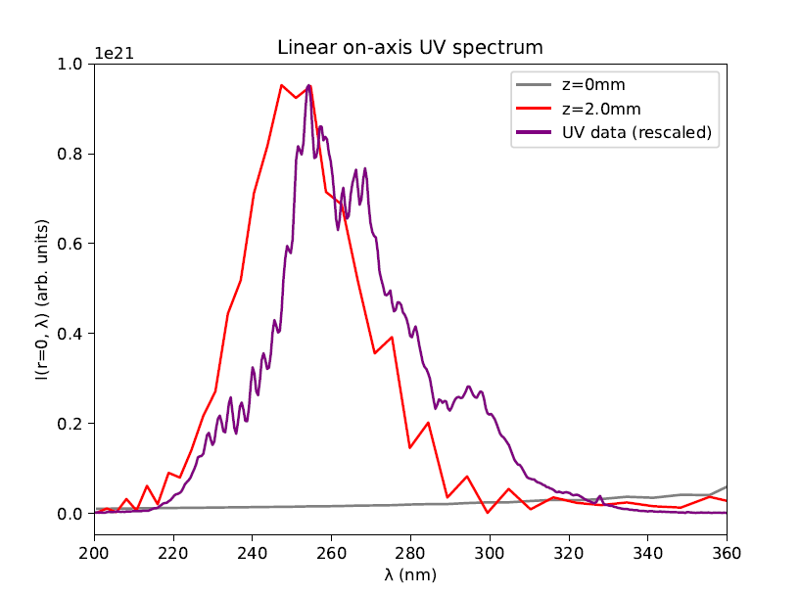
Pressure scan: spectra
Measured UV data
Simulated UV data
0.1 bar
0.2 bar
0.3 bar
0.5 bar
0.4 bar
0.6 bar

Slide 14
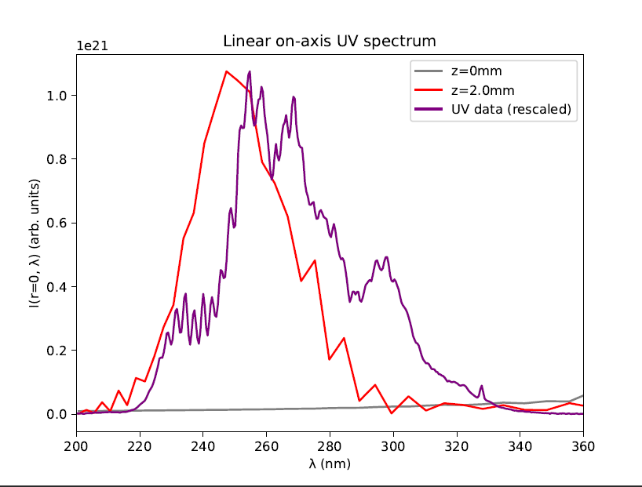
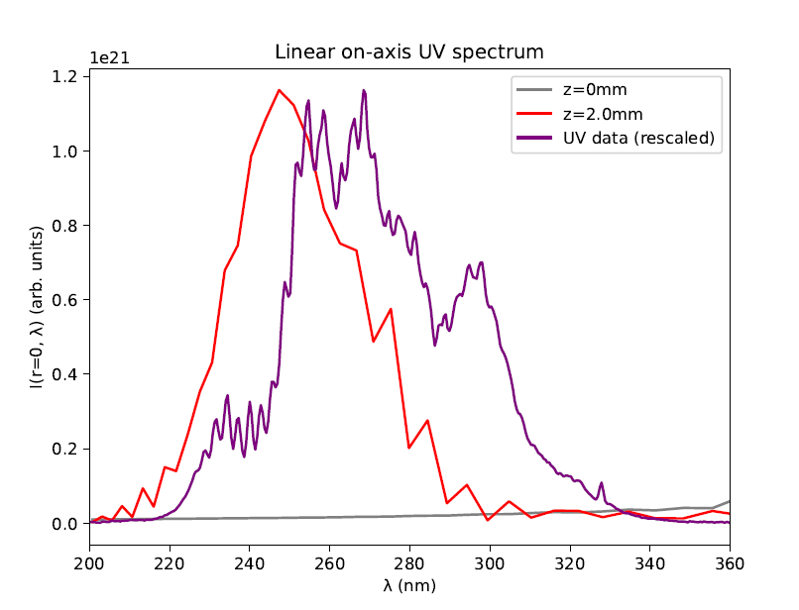
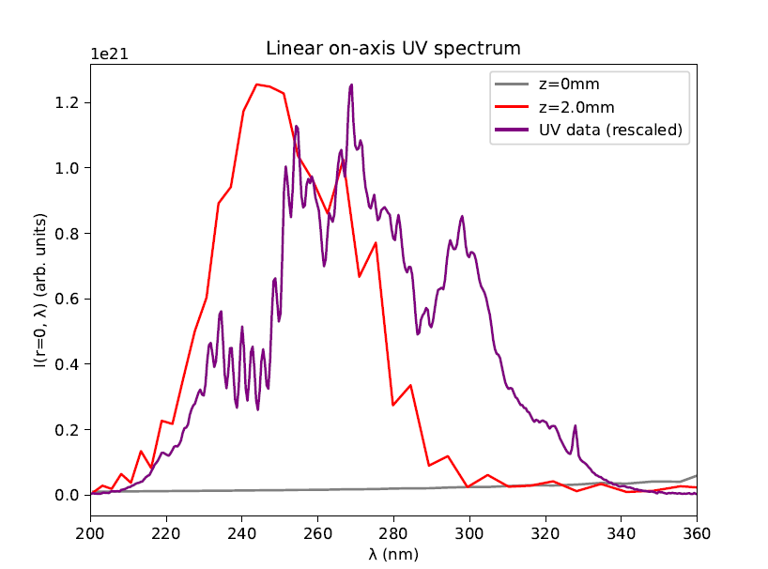
Pressure scan: spectra
Measured UV data
Simulated UV data
0.7 bar
0.8 bar
1.0 bar
Additional spectral peaks not observed in simulations

Slide 15
Conclusions
For some pressures (~0.4bar) there is fairly good agreement between the measurements and the simulations
At high and low pressures, simulations and data diverge
Possible reason: breakdown of pressure gradient model
Try using COMSOL simulations of gas density instead?!
Alternative reason: nonlinear model incomplete
???

Slide 16
Next steps?
Get COMSOL simulation data for gas density?
Set up non-Gaussian spatial profile?
Measure CEO phase?
Get more data?
Input pulses at different beam energies (75mW, 150mW, 300mW,…)
UV spectra at more beam energies and gas pressures
UV data for Neon

Slide 17
THG Simulations
Project update
Week 3
09/08/2023
David Amorim

Slide 18
Overview
Since last week, over 30 different pressure scans were simulated
The following parameters were varied in the process:
Pressure
Input beam power
CEO phase
Ionisation (on/off)
Gas (Argon/Neon)
The raw data is available on Sync&Share

Slide 19
Overview
The resulting data has been analysed with respect to three main effects:
Saturation
Spectral profile
Beam profile
Self-steepening
Mostly focussed on the pulse properties at and around the saturation point
This analysis is still incomplete, with many factors left to consider (e.g. position of beam focus in the cell…)

Slide 20
I. SATURATION

Slide 21
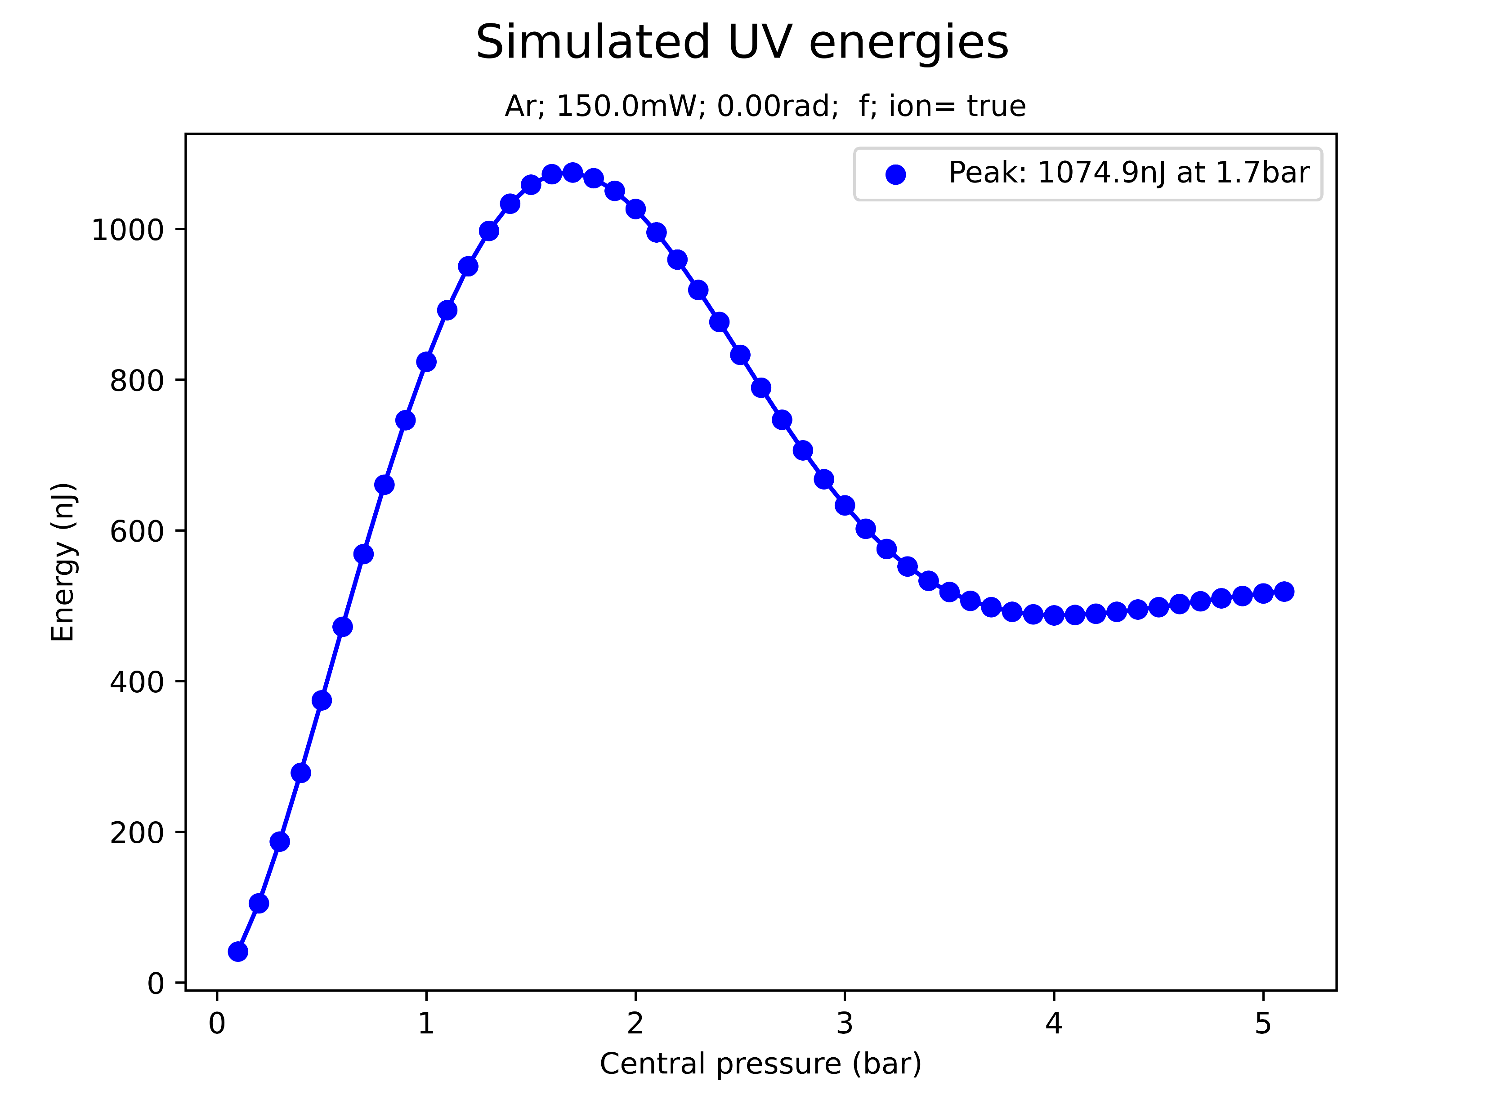
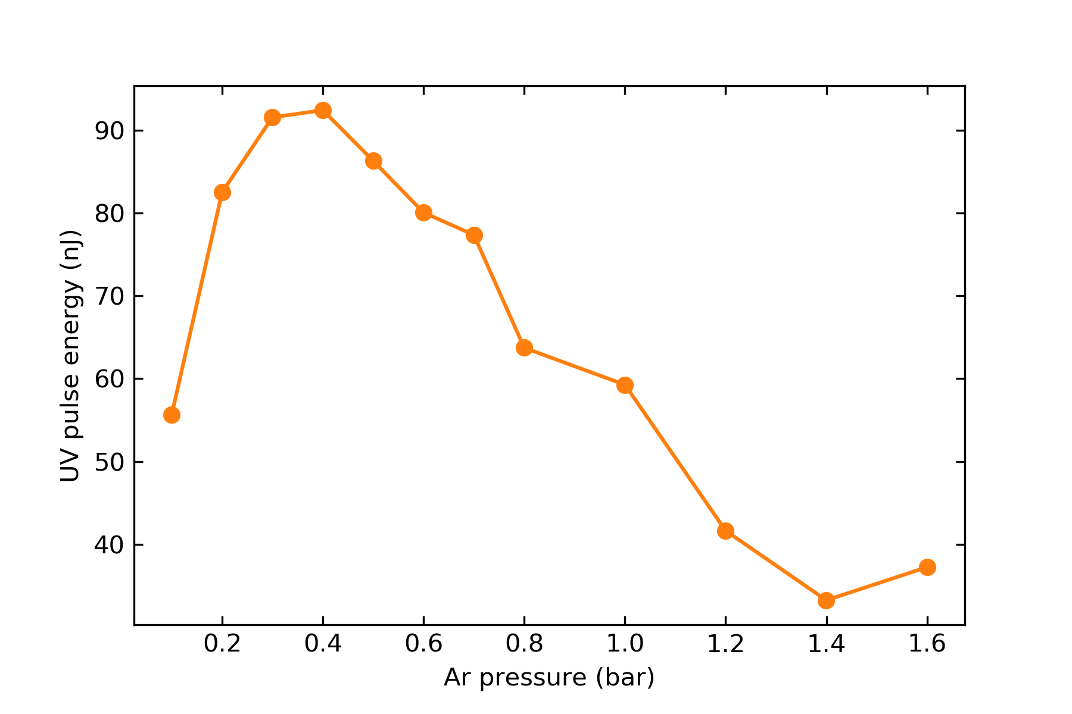
Saturation
simulated
At sufficiently high pressures, the simulation predicts a saturation in the UV energy
Qualitatively, this agrees with experiments
However, simulated saturation energies and pressures are much higher!
measured (same params)

Slide 22
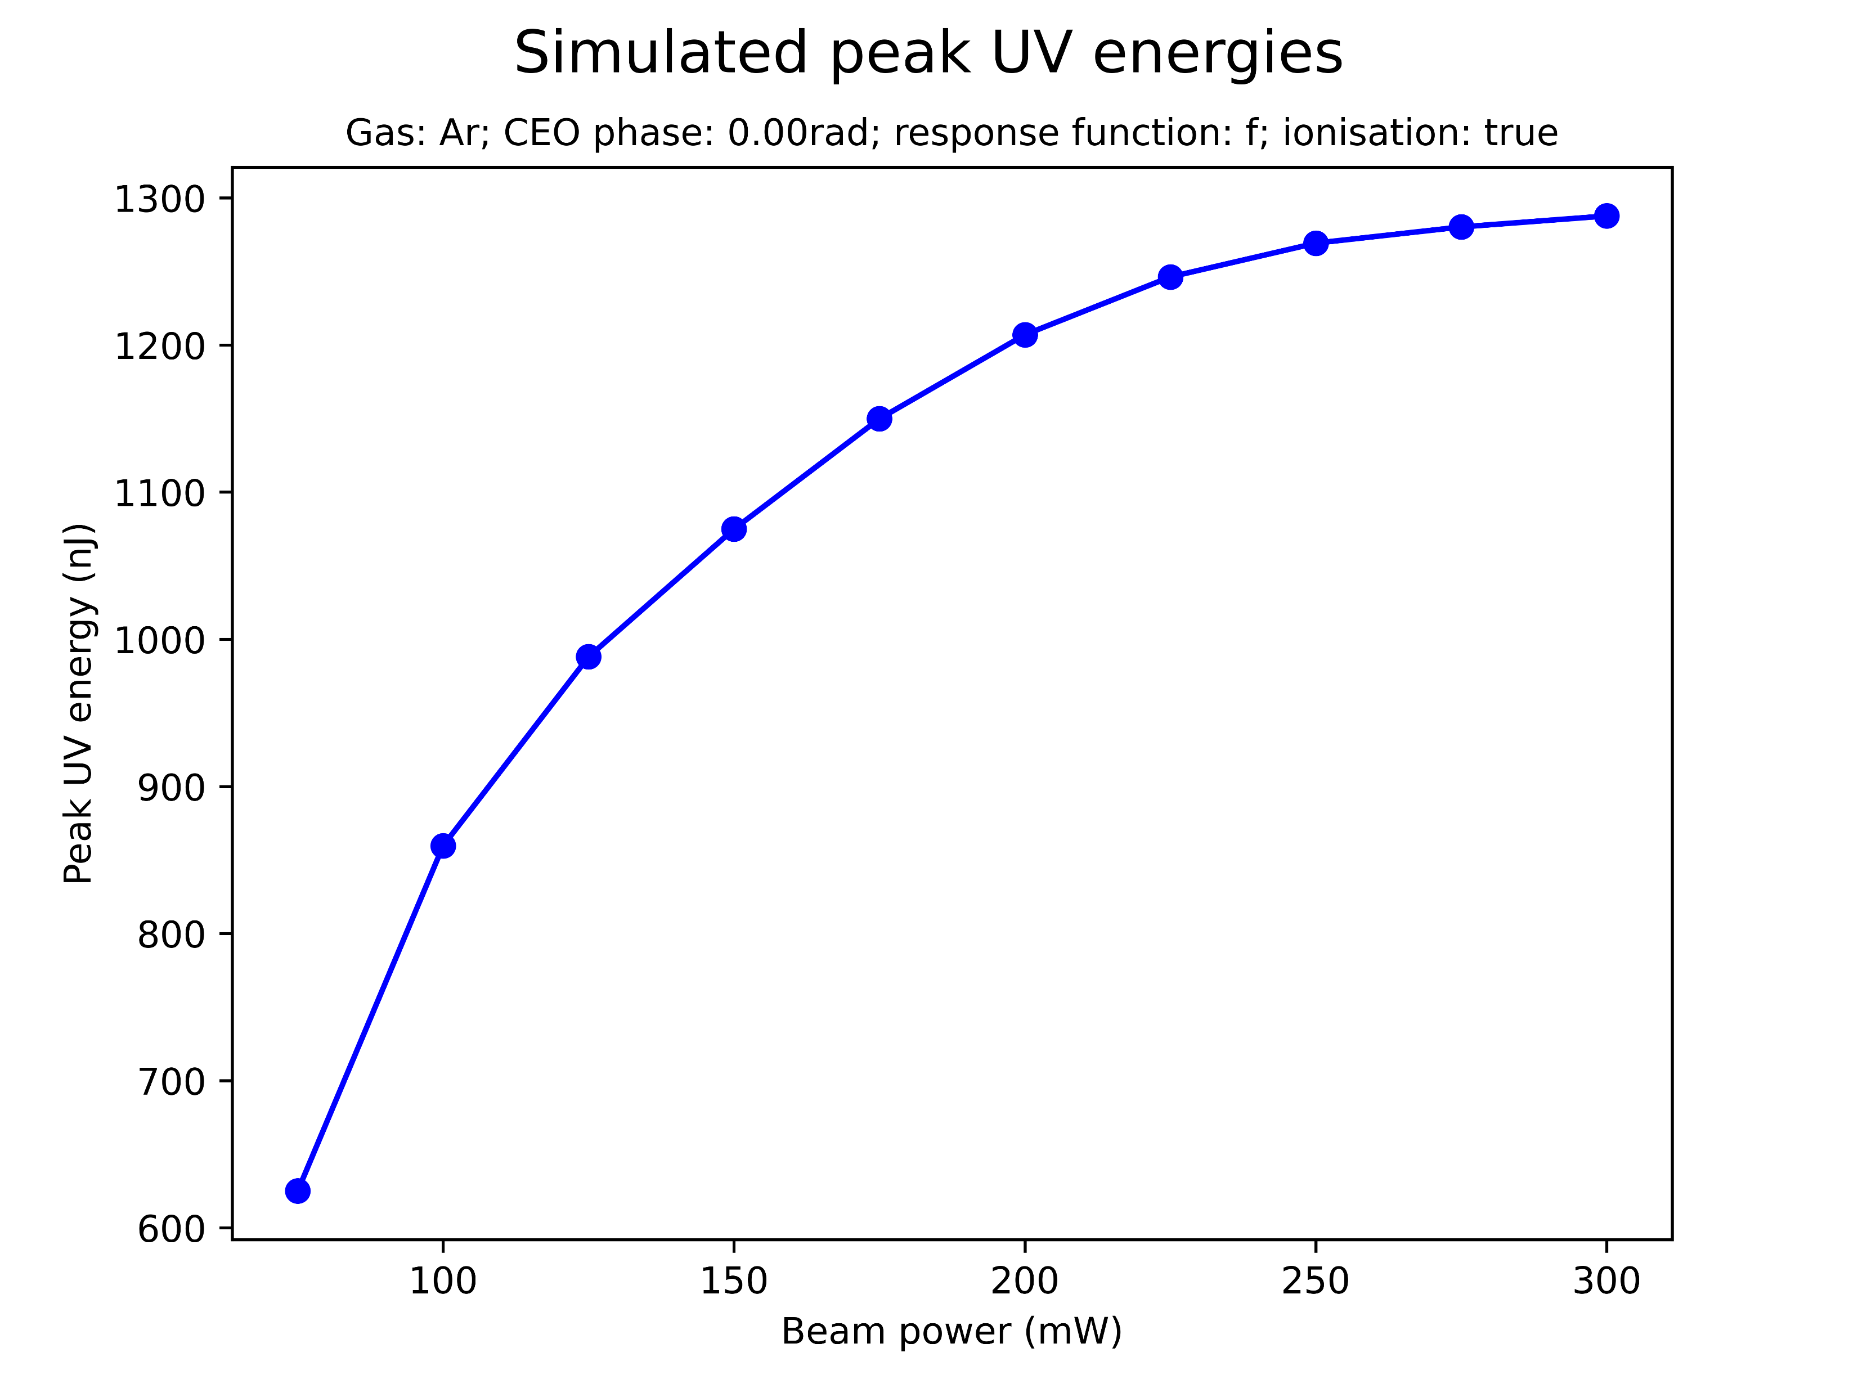
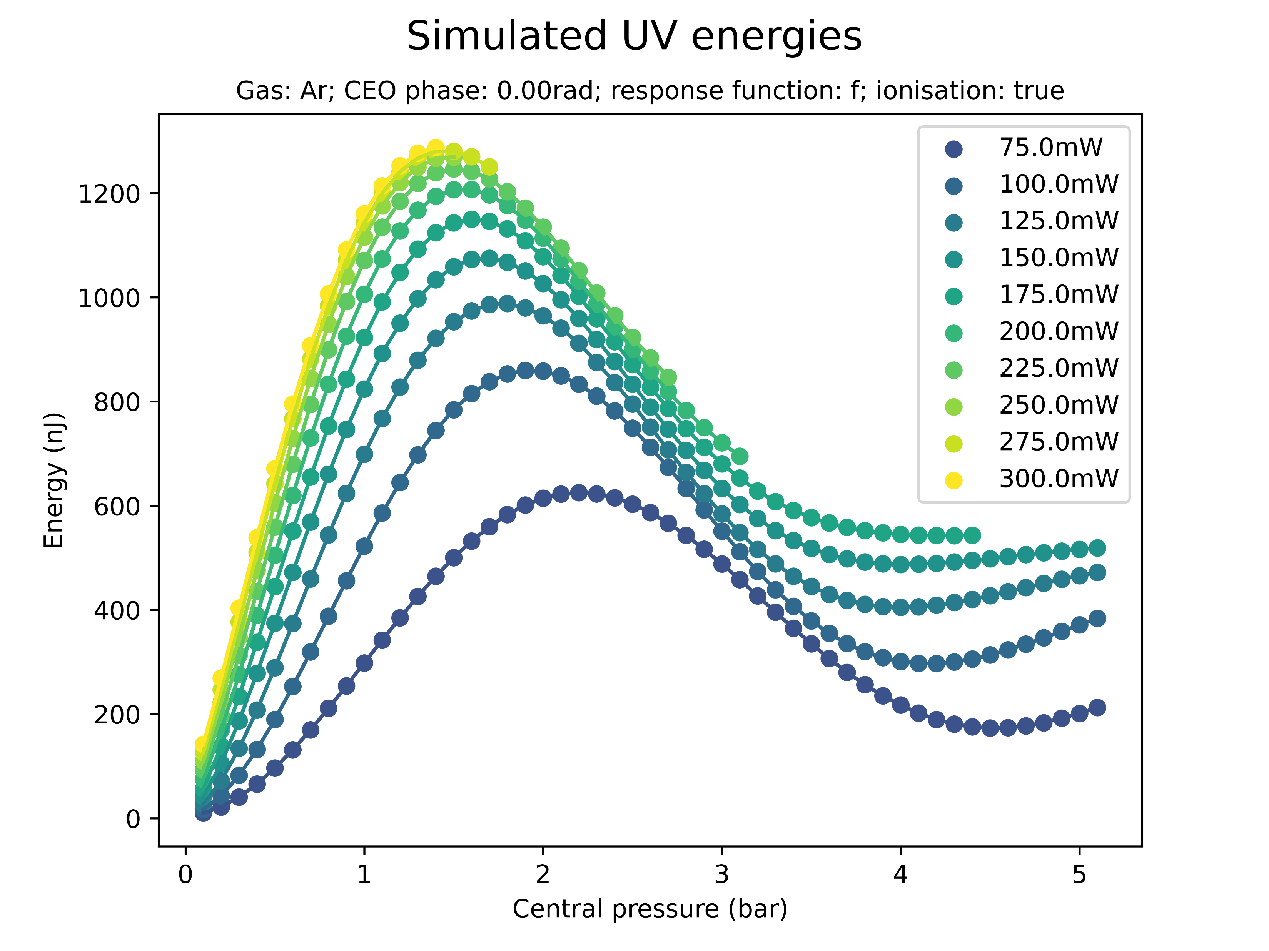
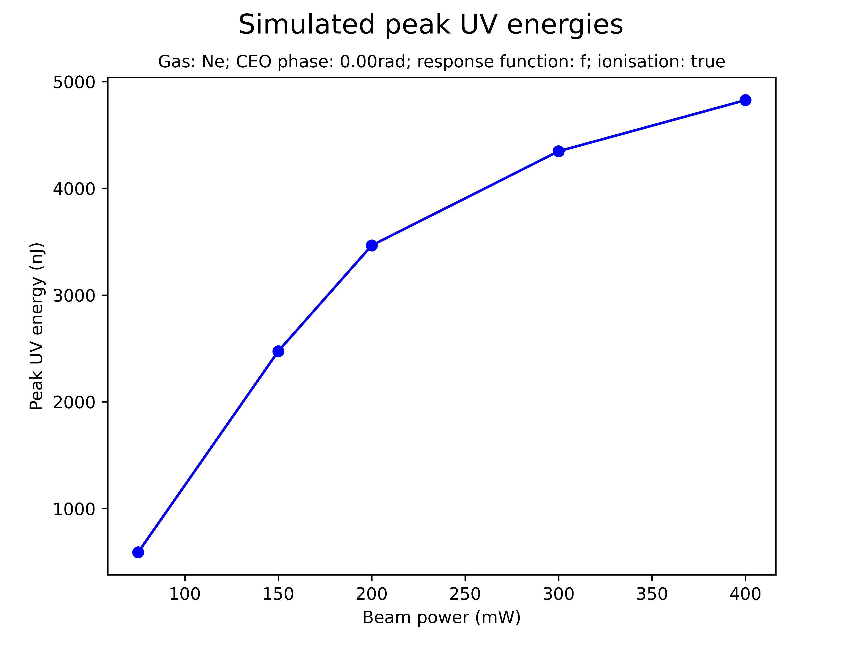
Effect of beam power on saturation
Increasing the beam power increases the peak UV energy
There seems to be a threshold at roughly 1300nJ

Slide 23
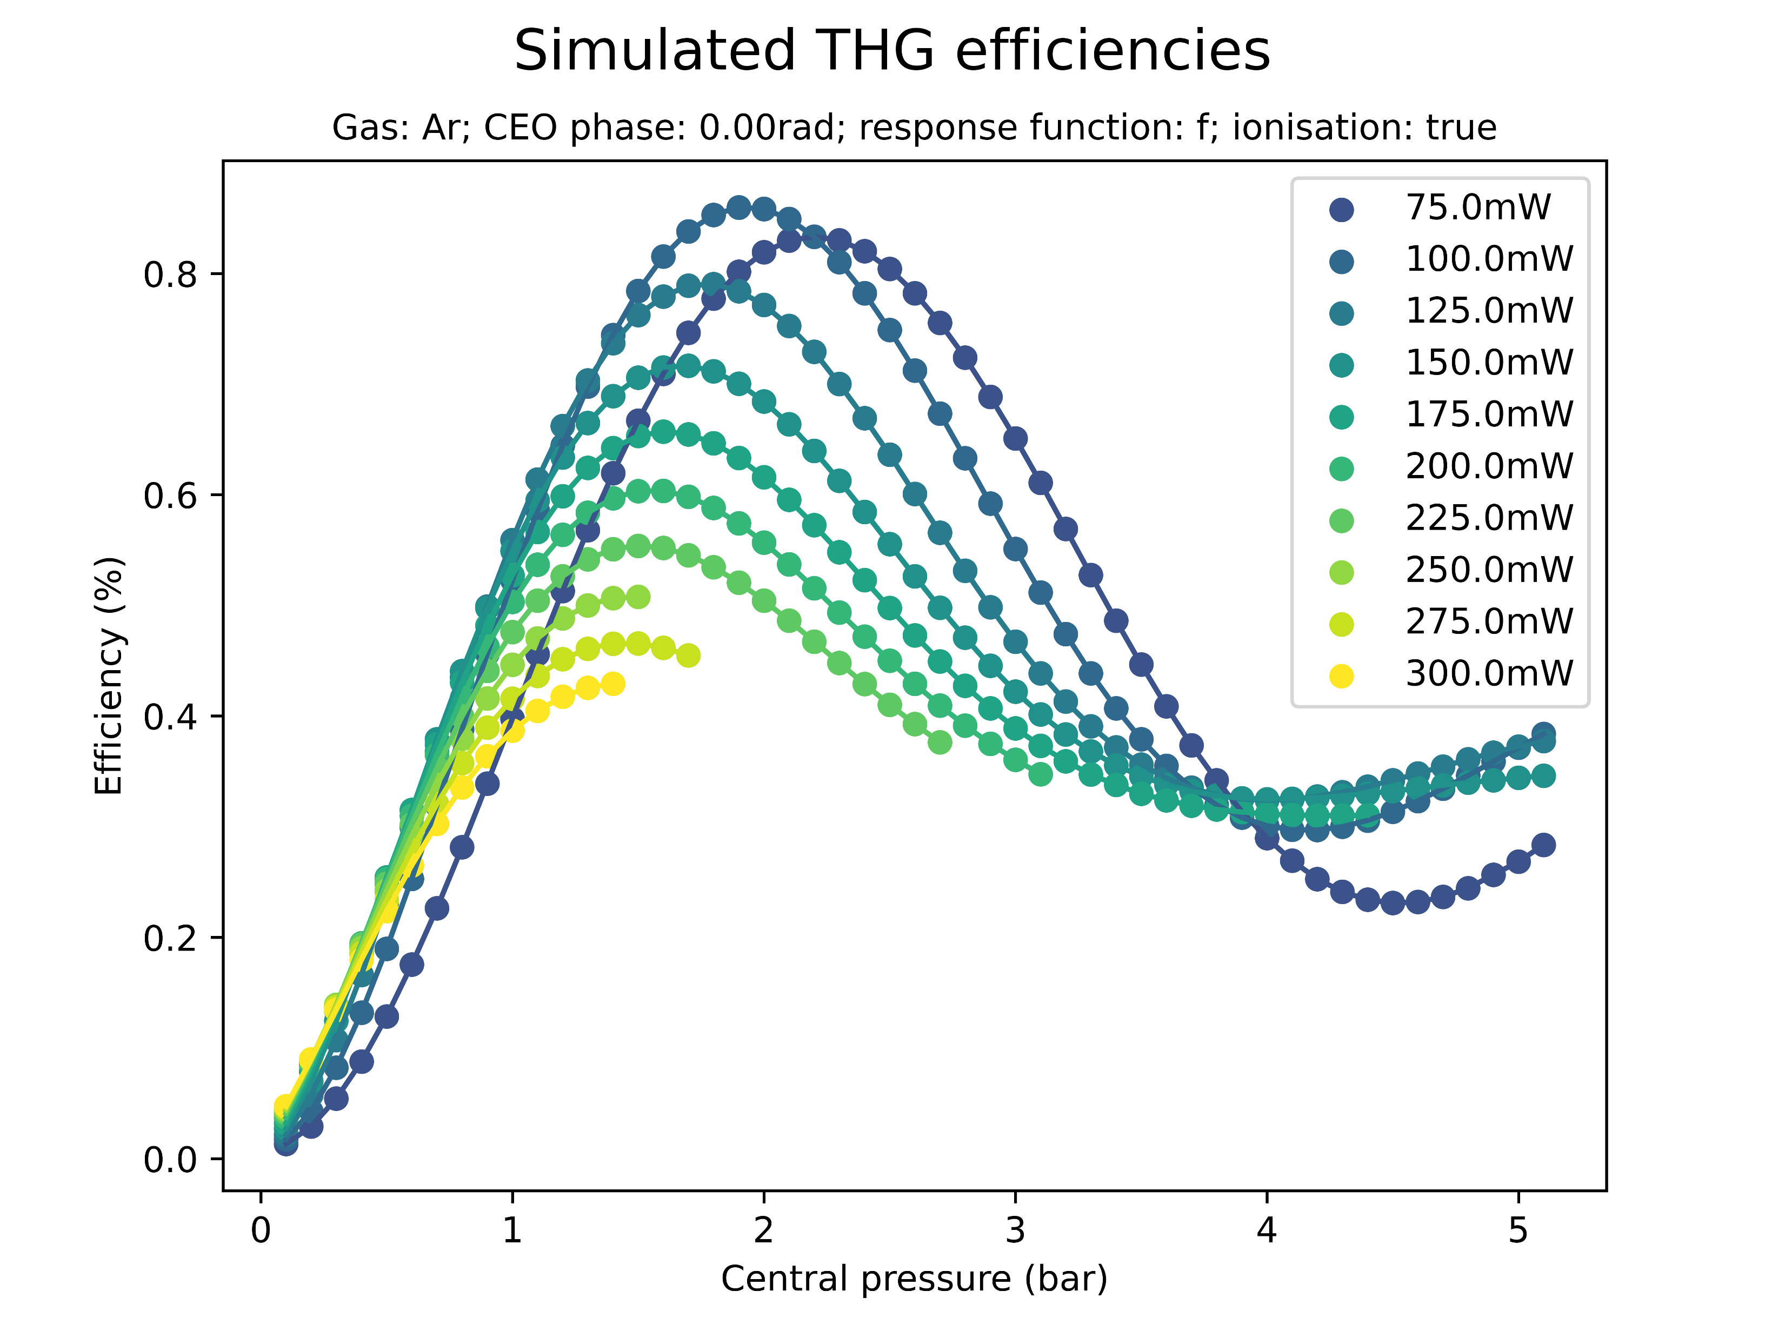
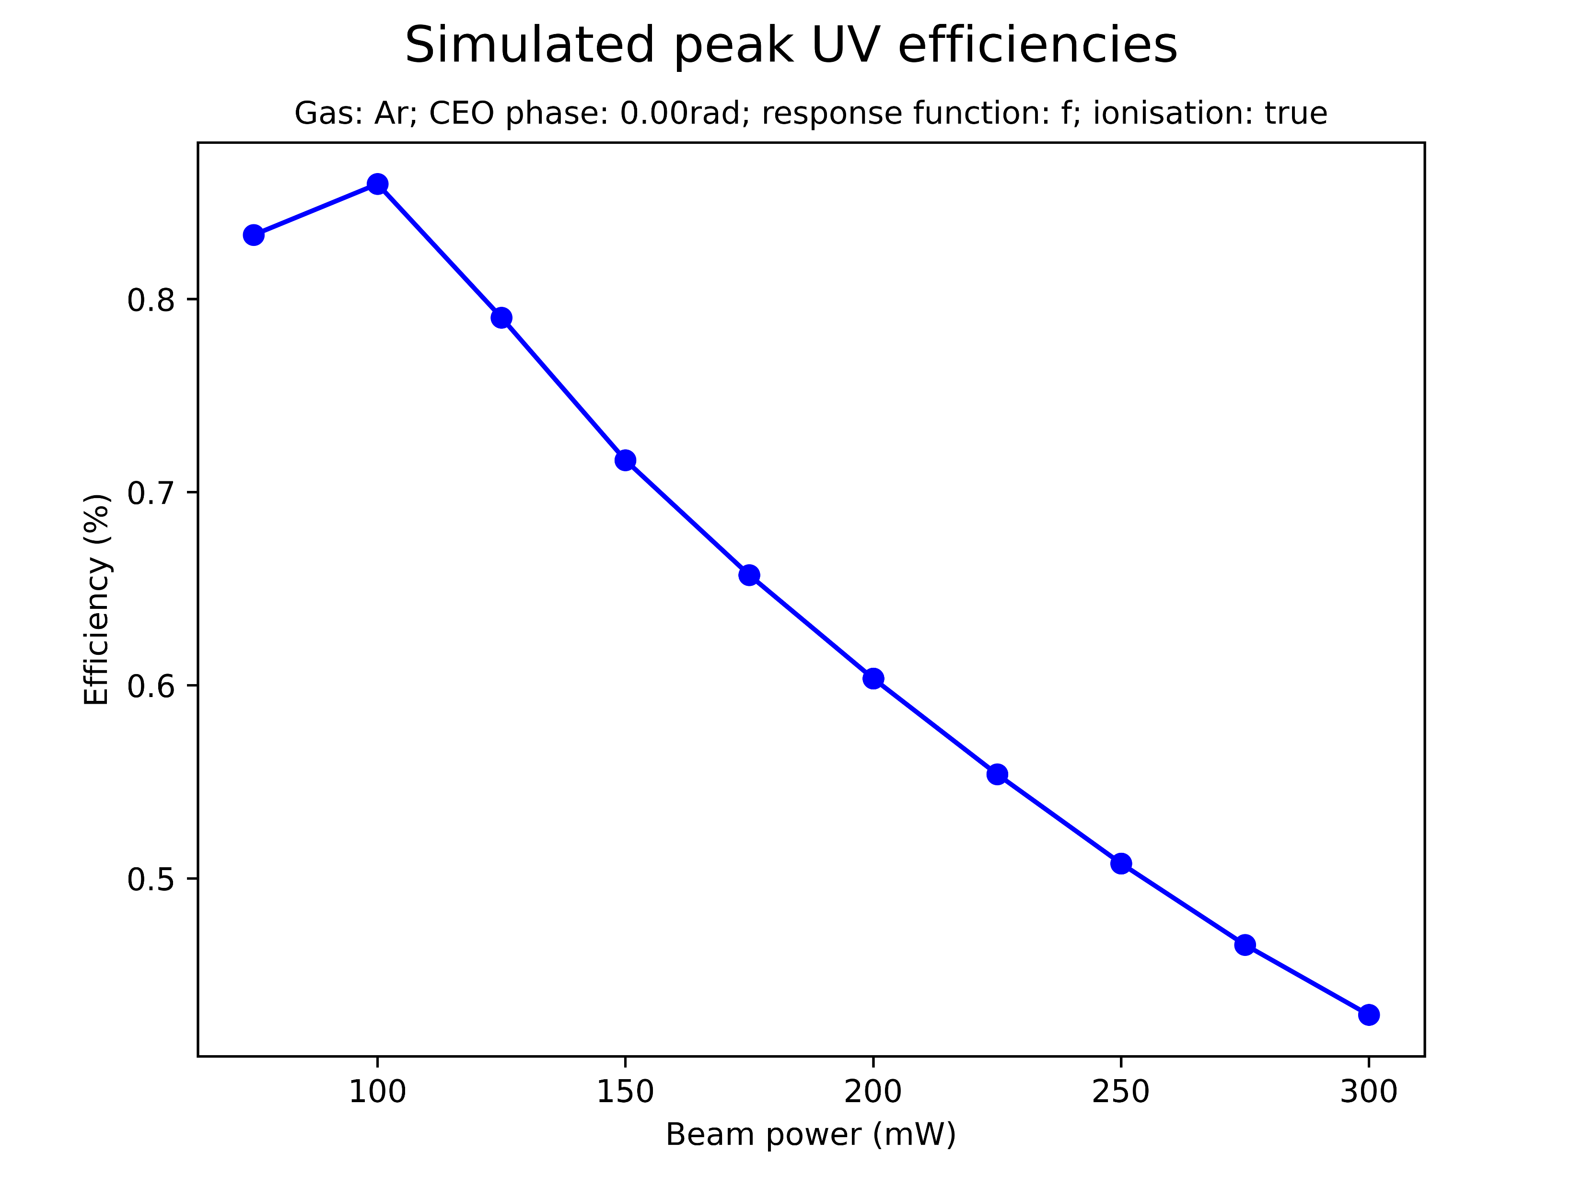
Effect of beam power on saturation
Increasing the beam power decreases the peak THG efficiency
This ensures the peak UV energy threshold

Slide 24
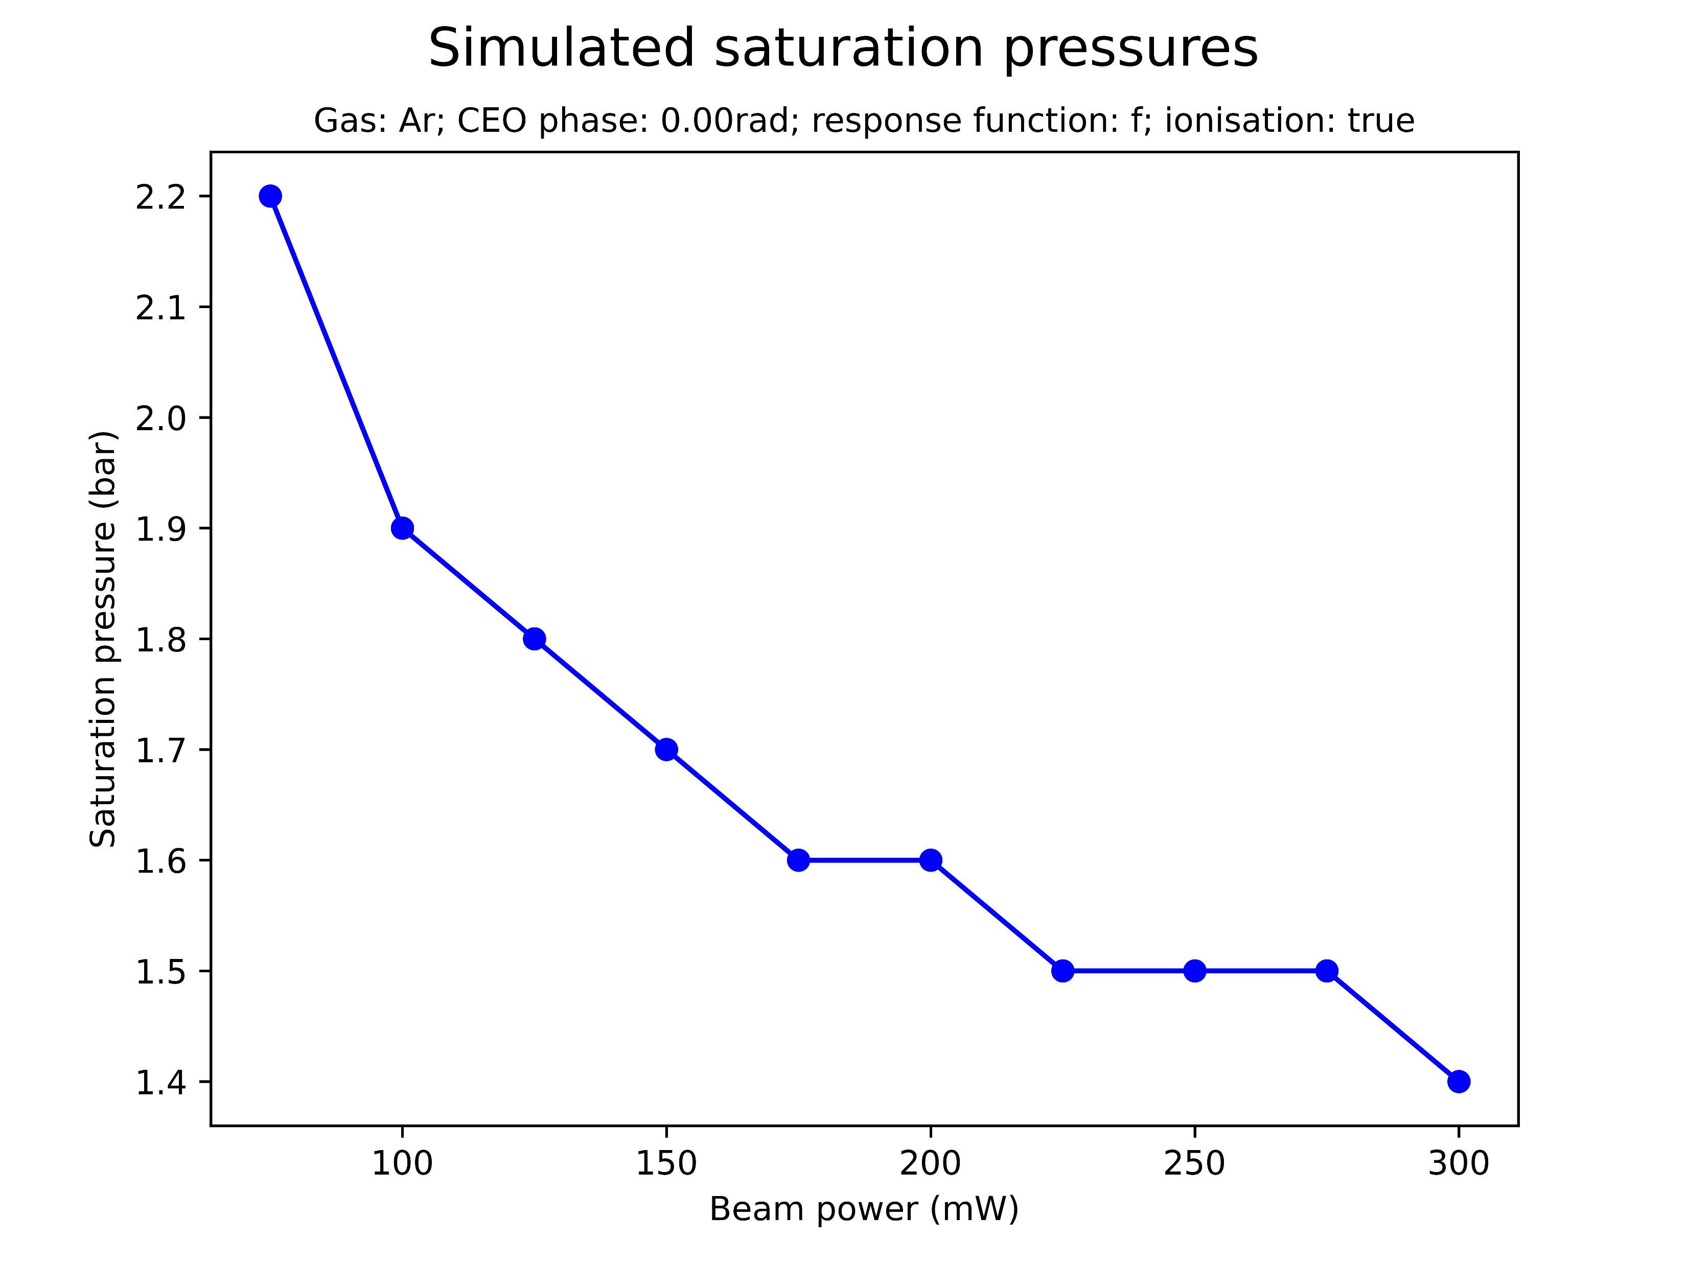
Effect of beam power on saturation
Increasing the beam power decreases the saturation pressure
For high beam powers the simulations broke down at pressures beyond the saturation point

Slide 25
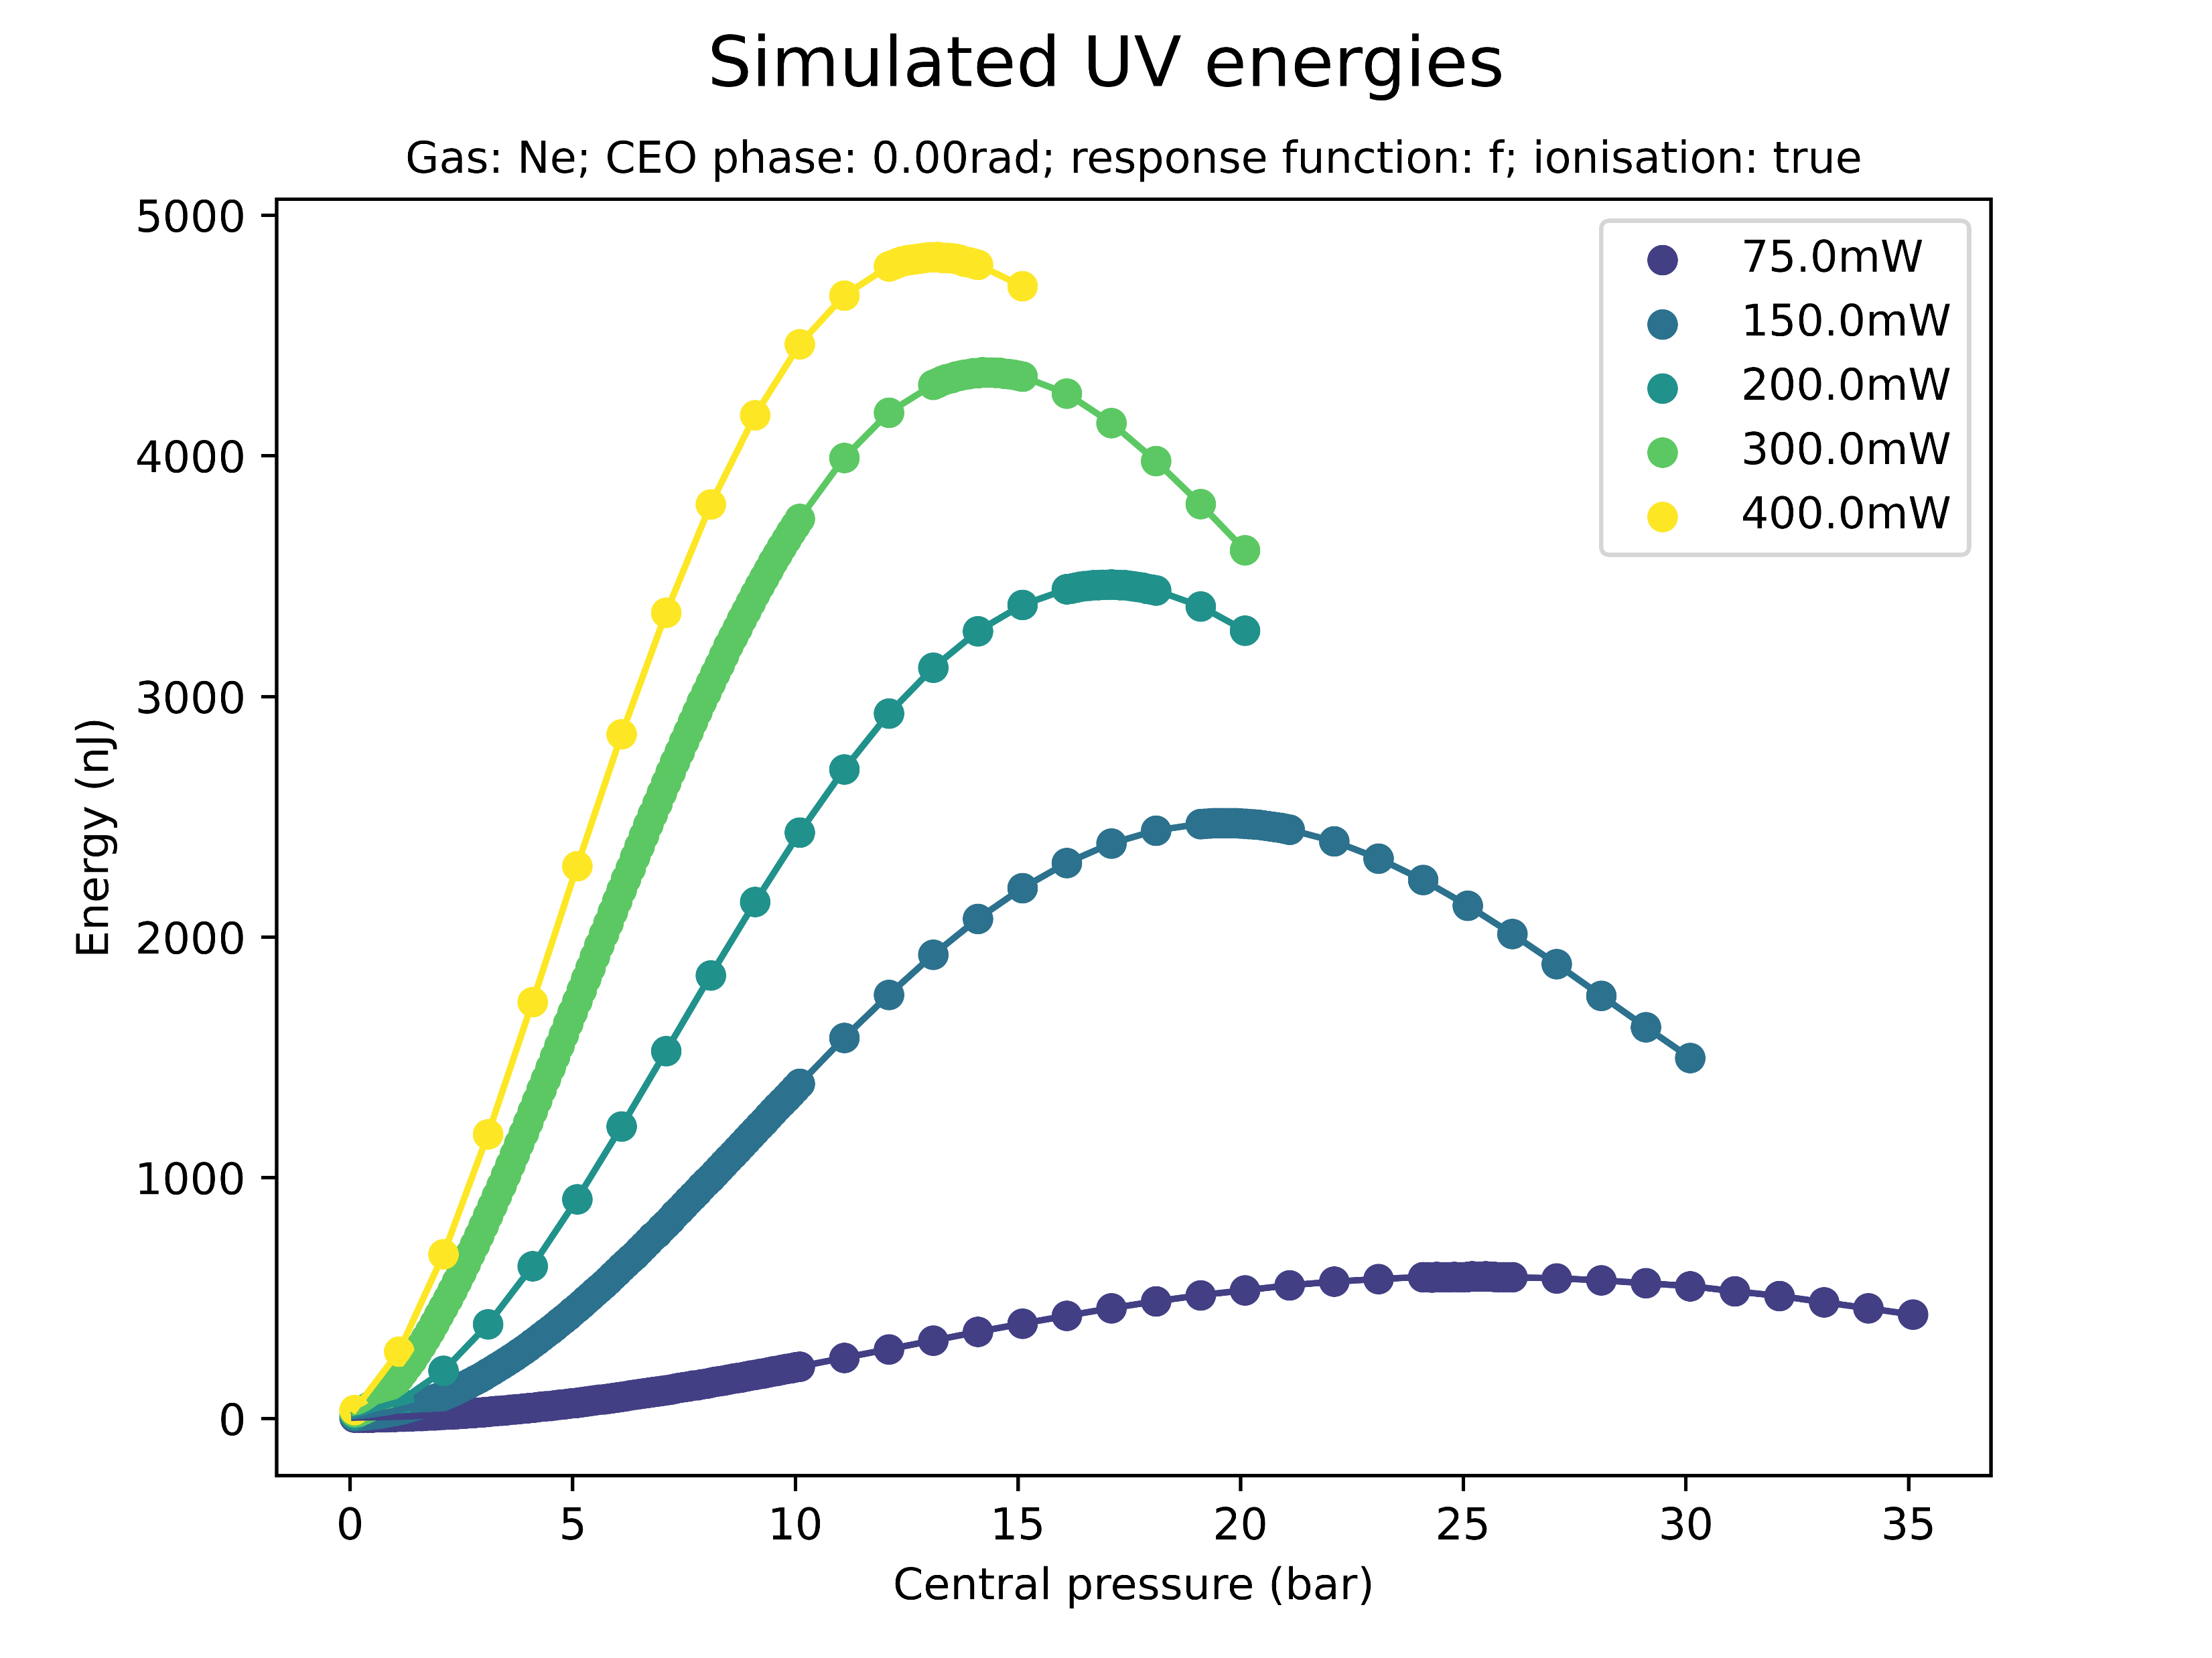
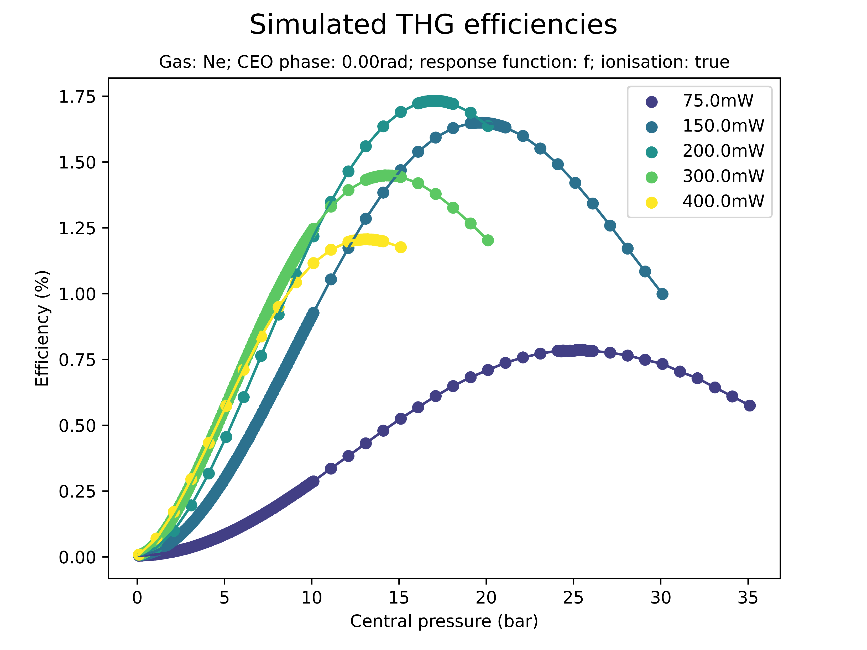
Effect of beam power on saturation (Ne)
Equivalent effects were observed for Neon
Energies, pressures, and beam powers involved are much higher than for Argon

Slide 26
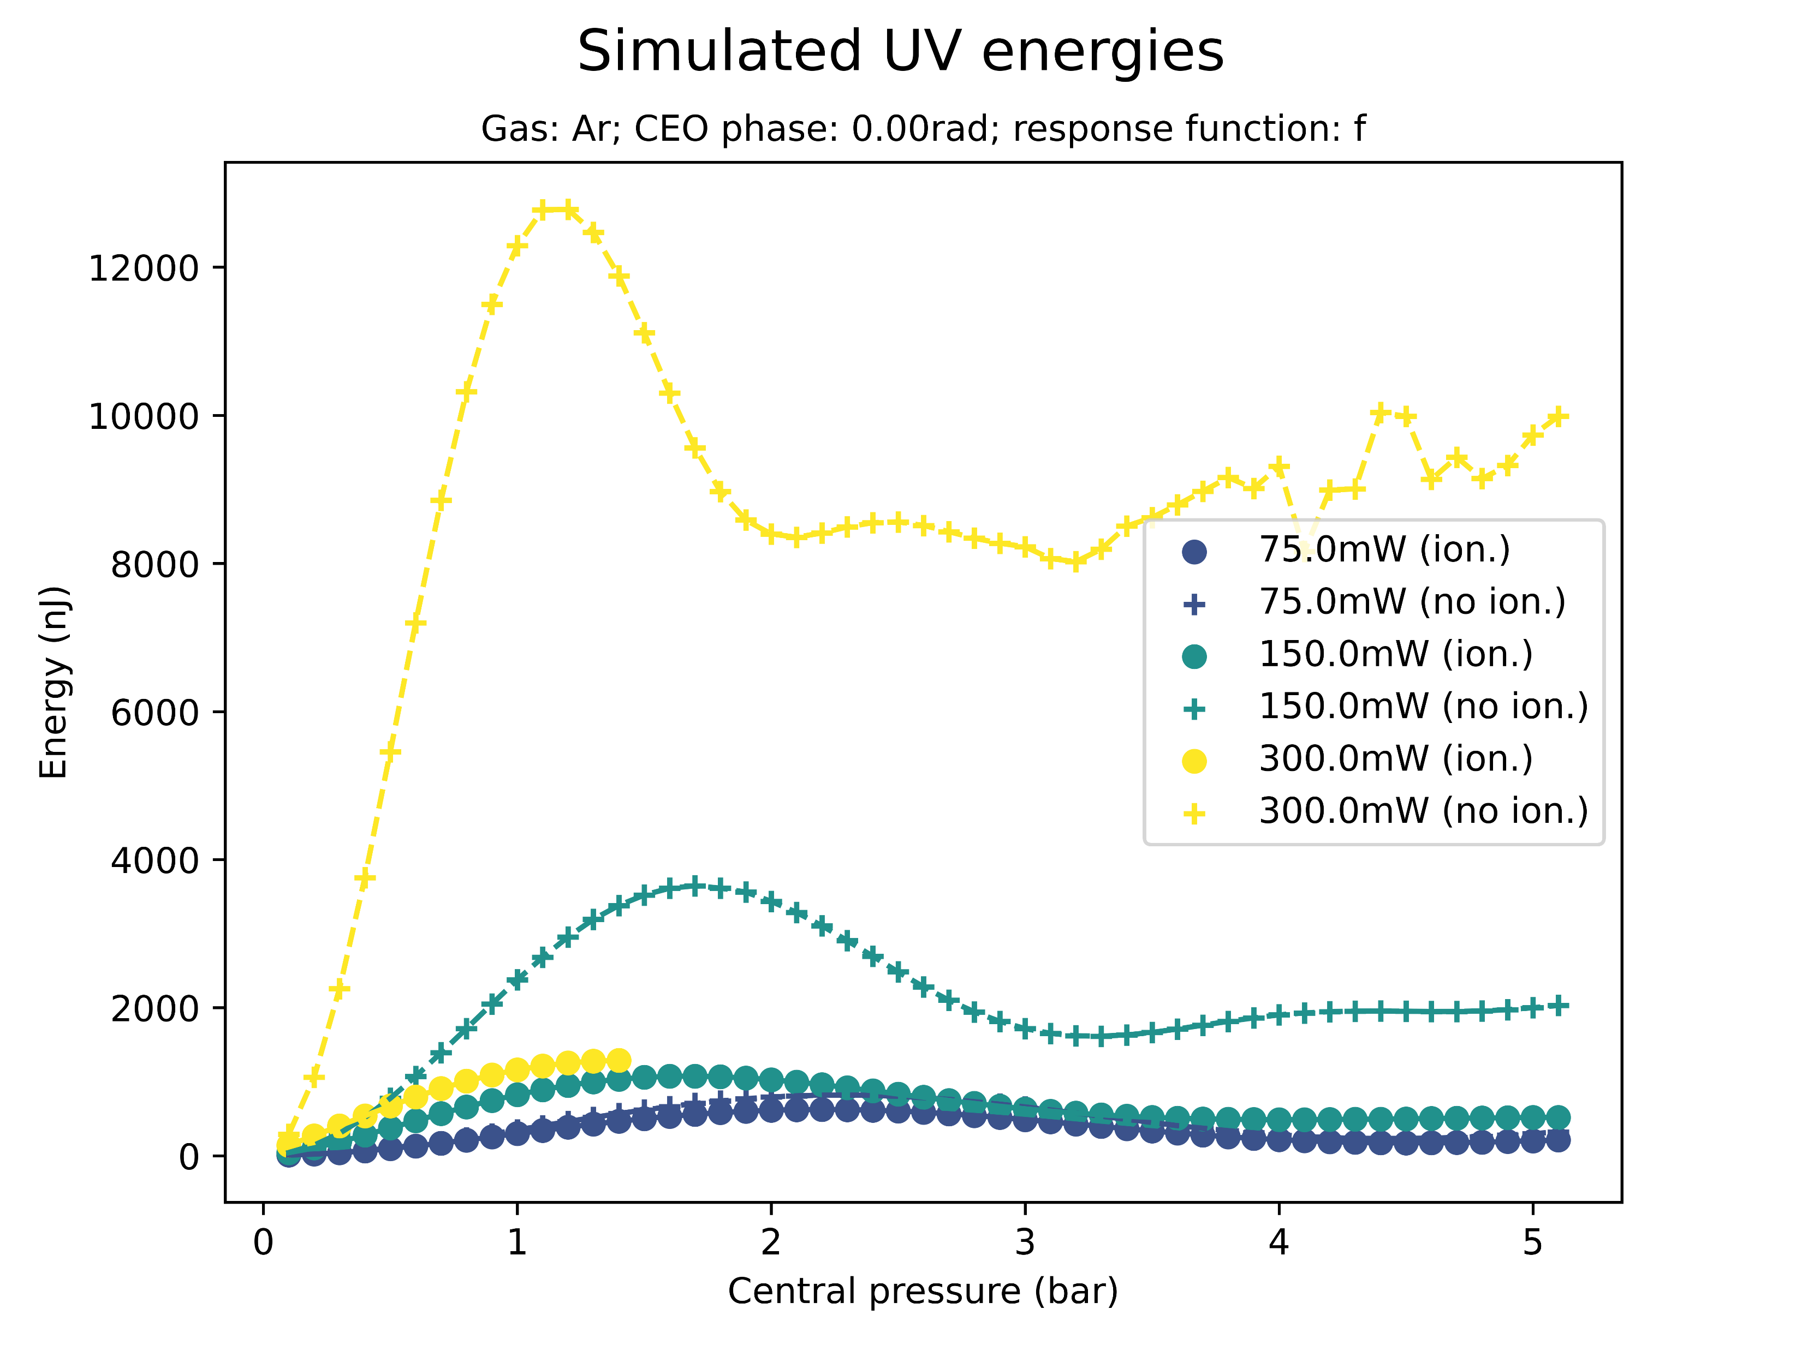
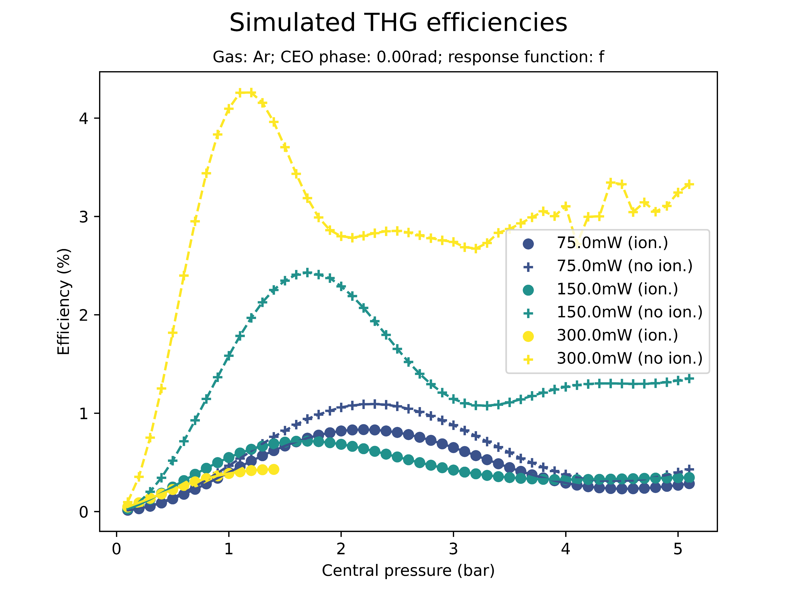
Effect of ionisation on saturation
Saturation sets in even when the ionisation response is turned off
Without ionisation, peak energies and efficiencies are significantly higher; saturation pressure is largely unaffected

Slide 27
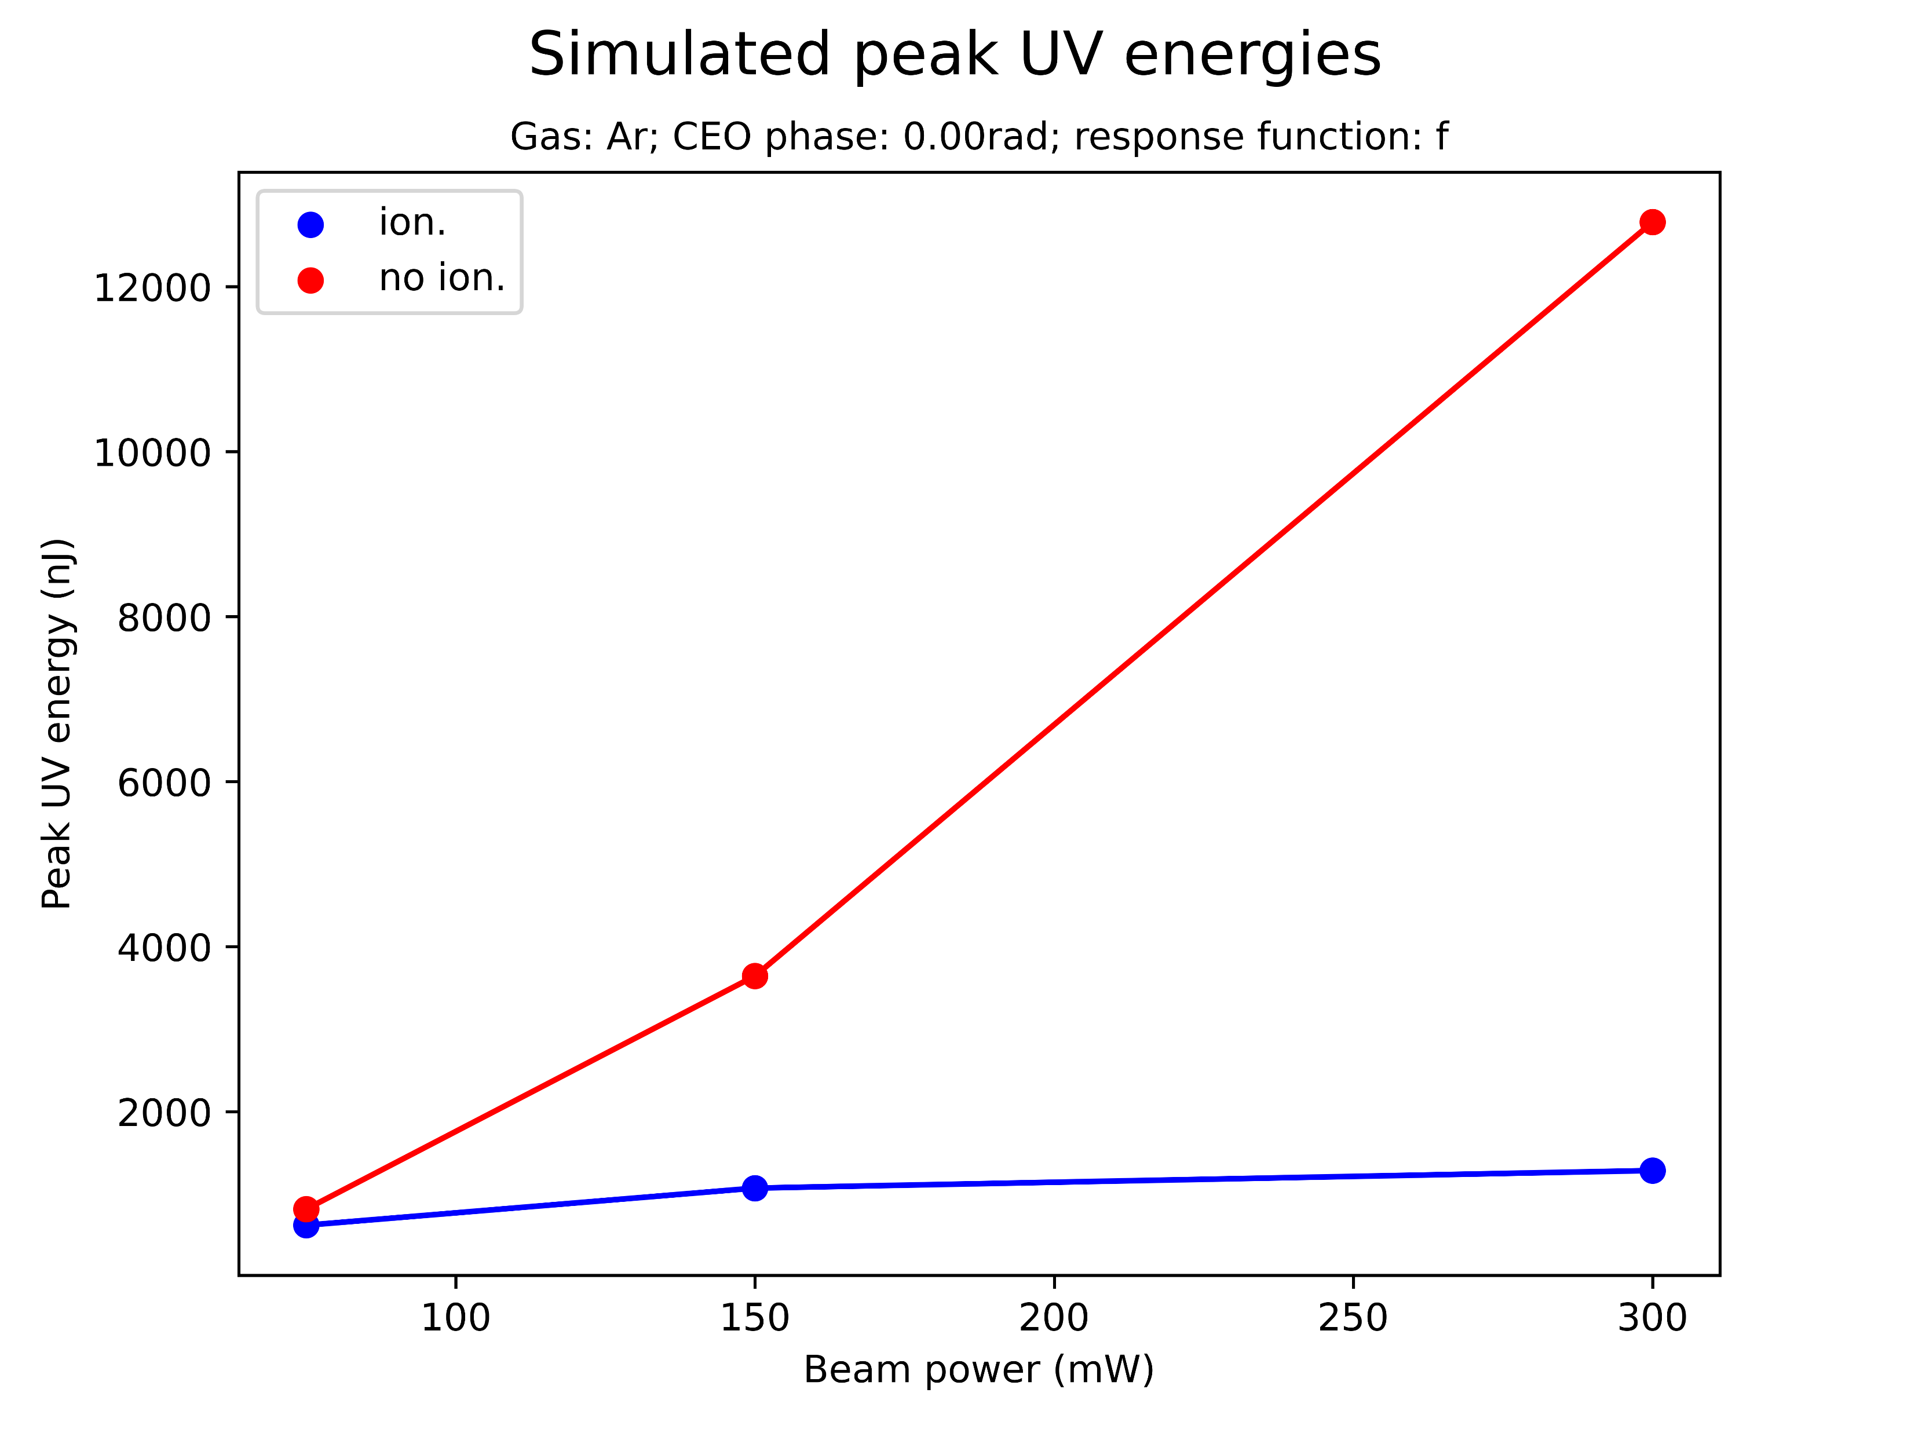
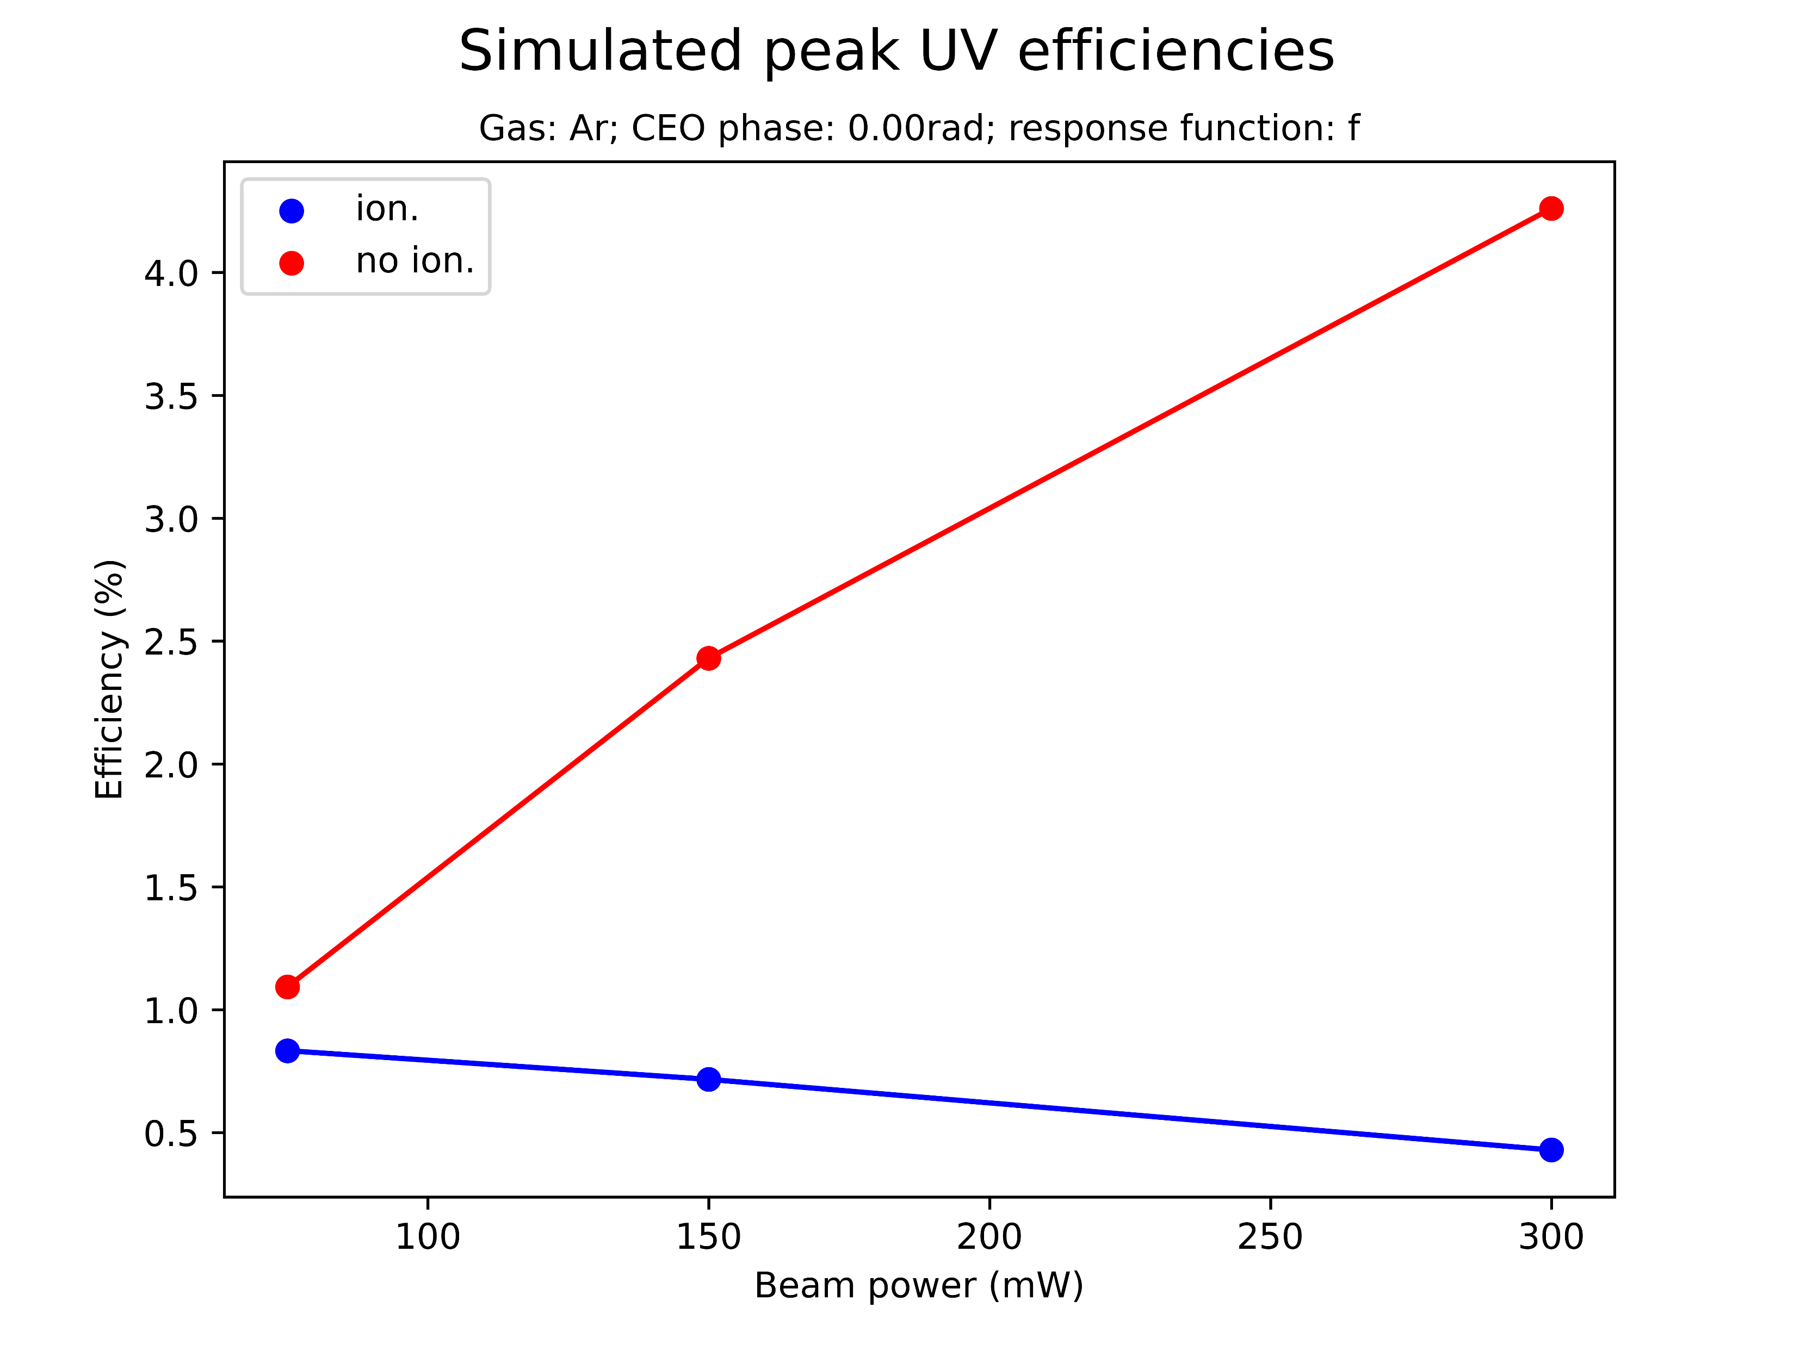
Effect of ionisation on saturation
Is there also a threshold UV energy value without ionisation? Does efficiency eventually decrease with beam power?

Slide 28
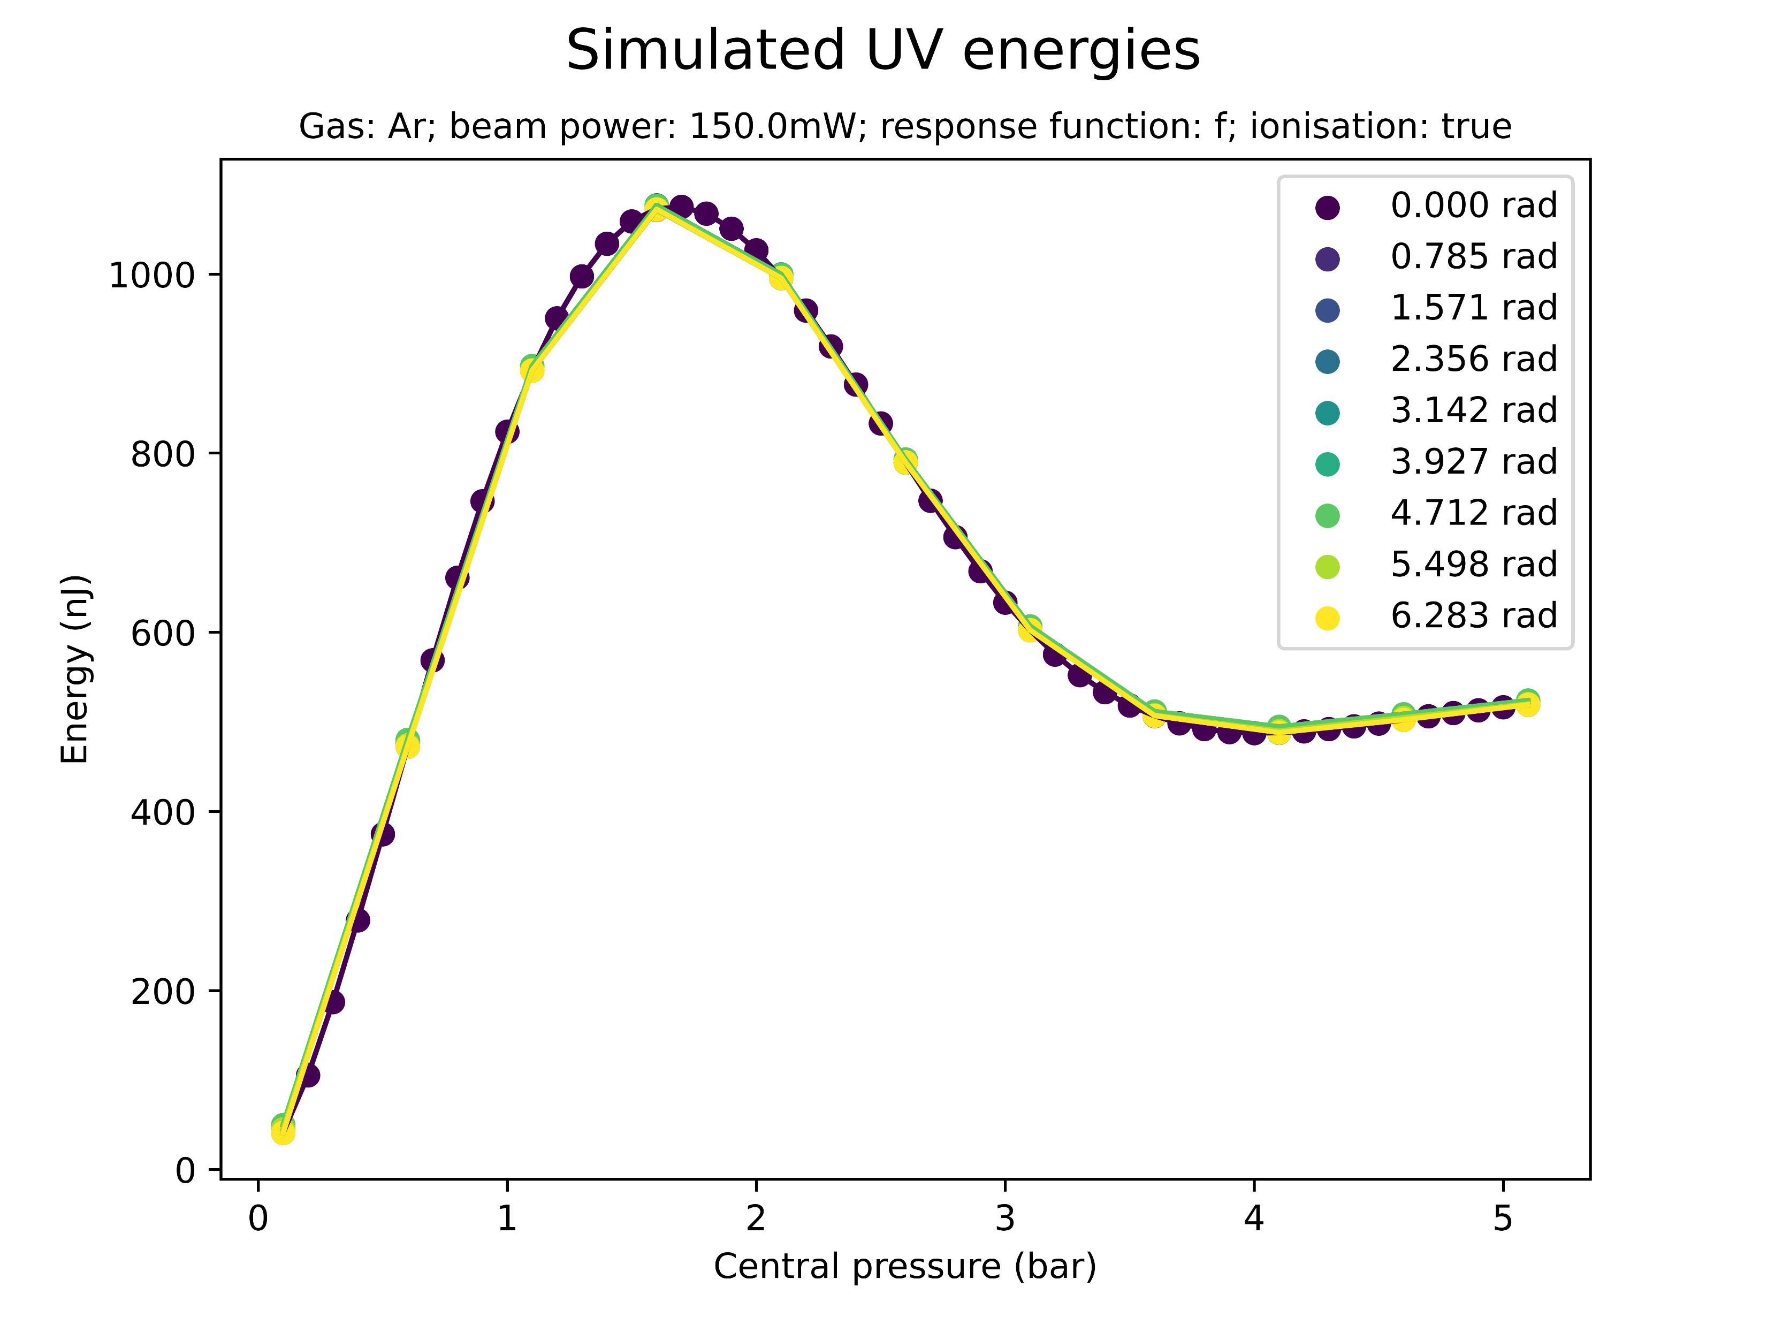
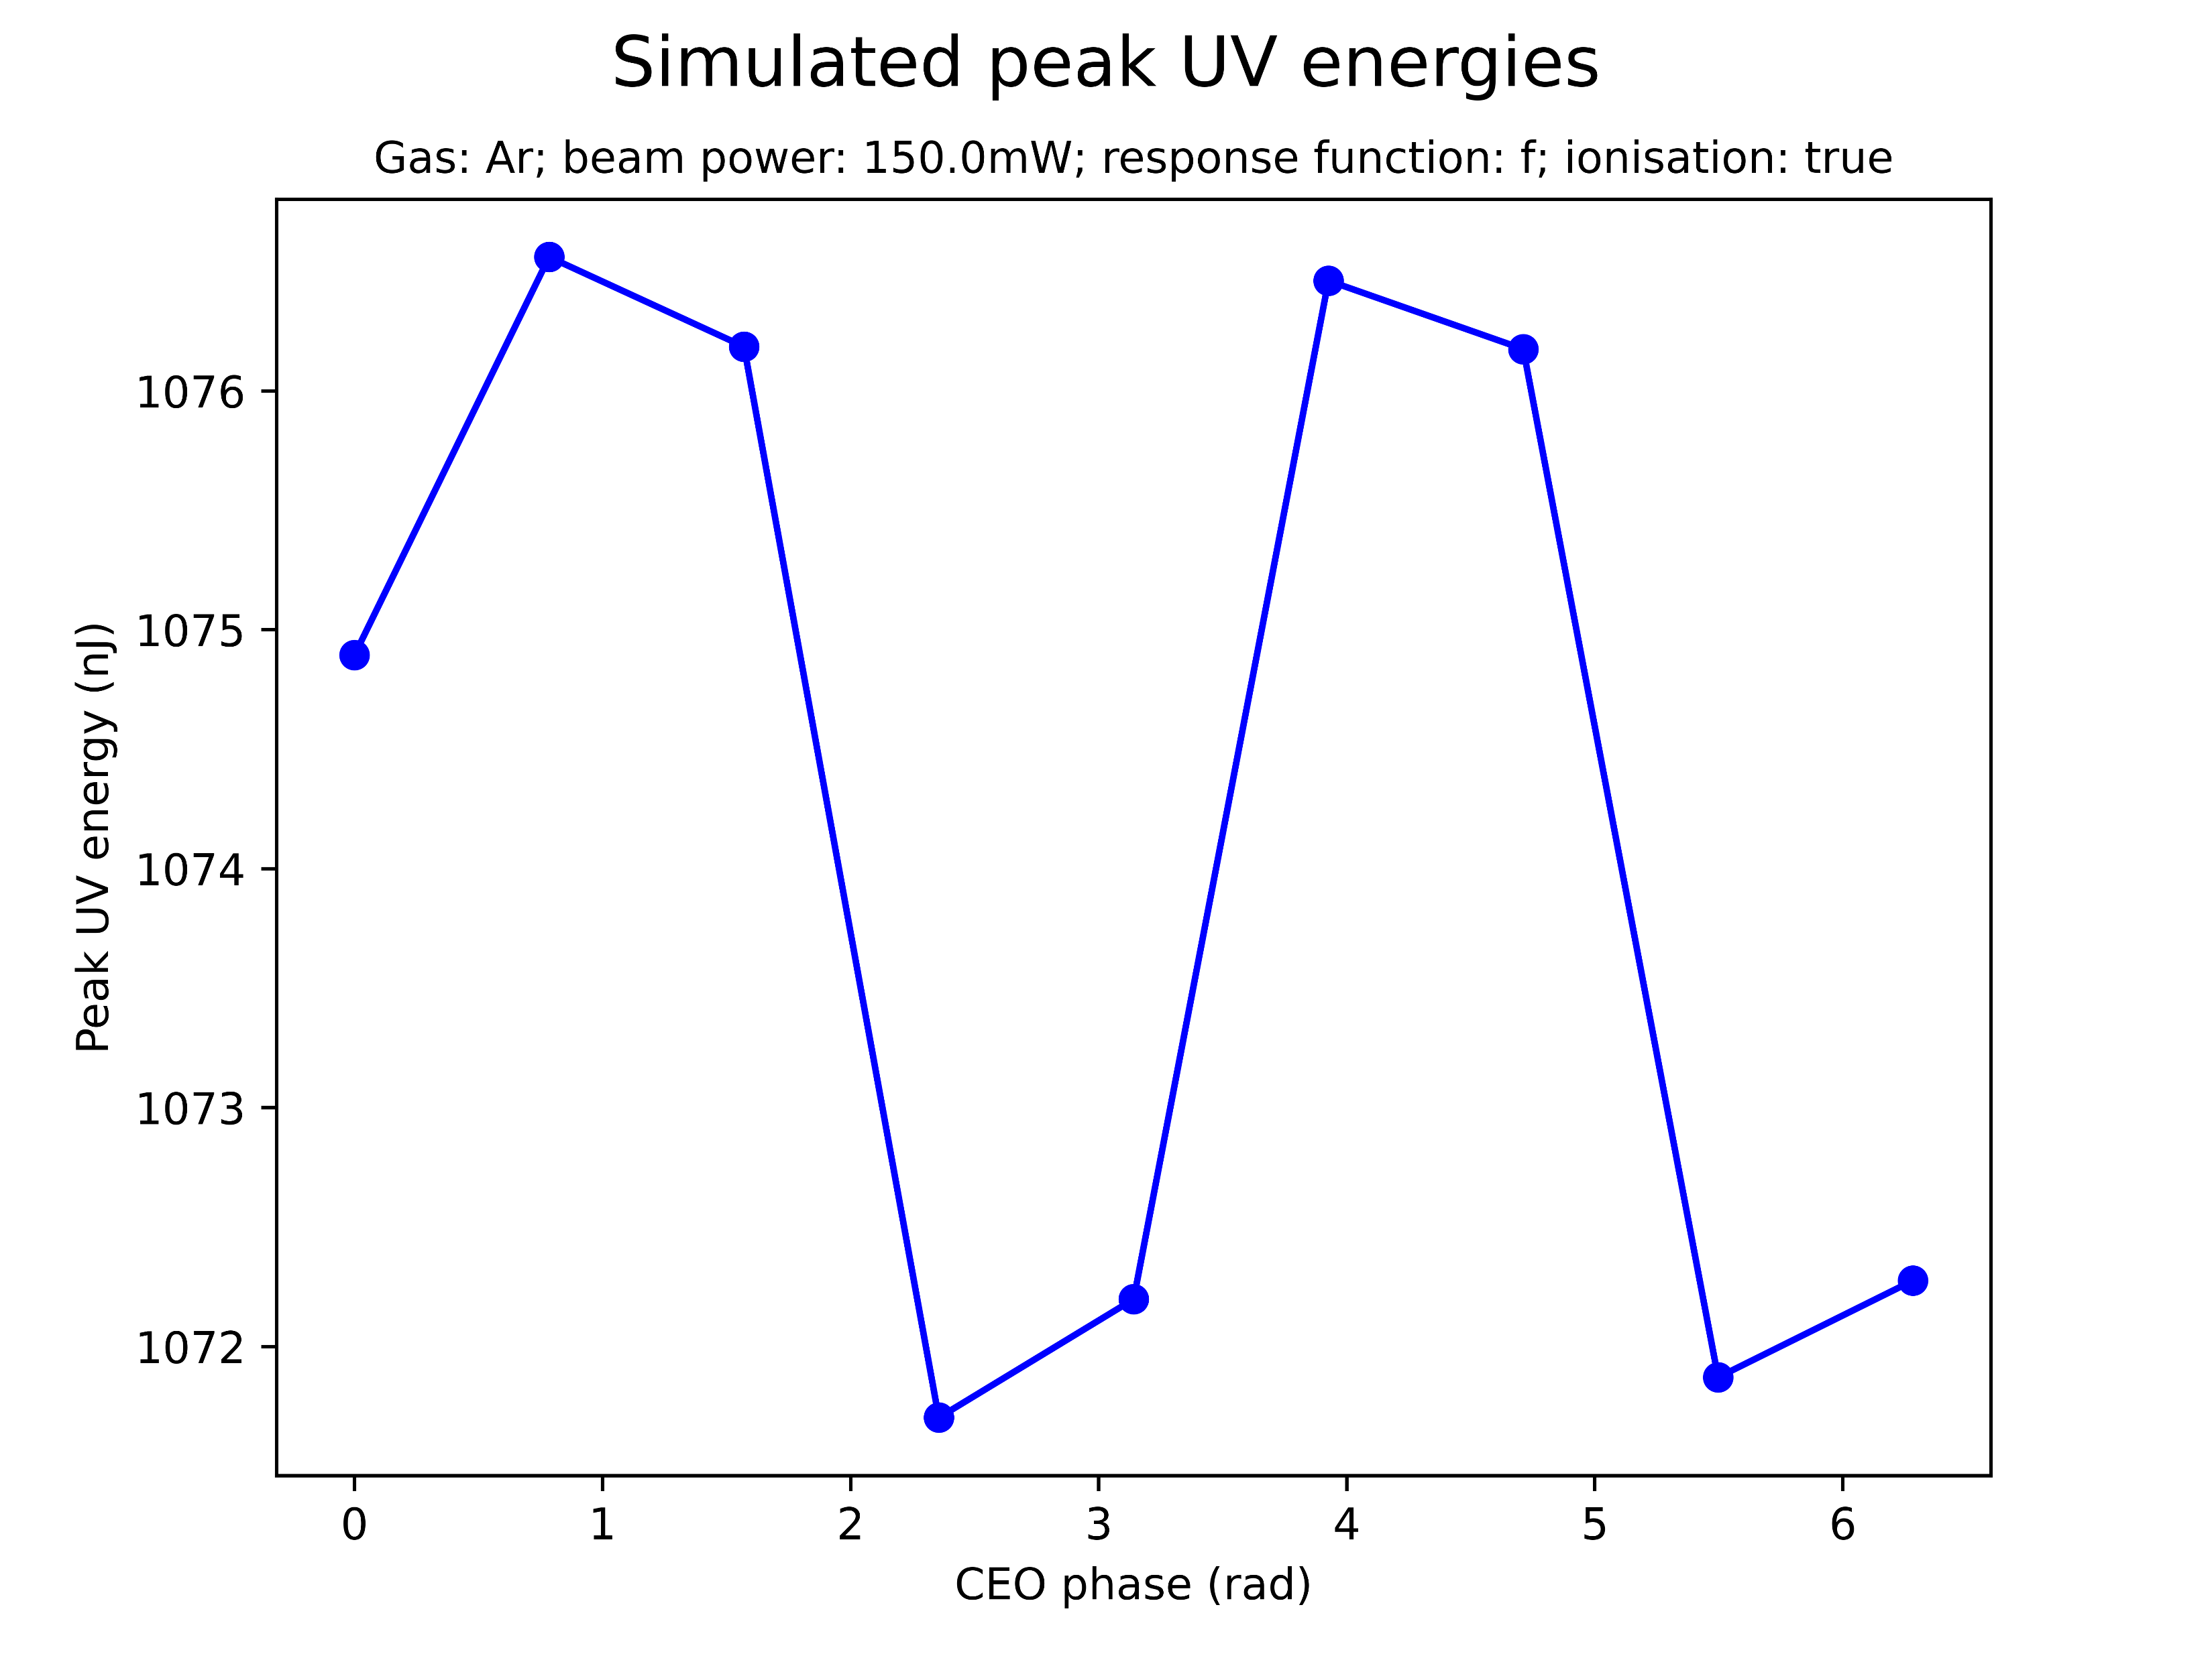
Effect of CEO phase on saturation
Negligible sinusoidal variation of peak UV energy/peak THG efficiency with CEO phase
Note: only tested for 150mW Argon

Slide 29
Summary: saturation
Saturation occurs at significantly higher energies and pressures than in the experimental data
Can the pressure discrepancy be explained by the pressure measurement having been taken outside the cell?
Saturation is correlated to input beam power: at higher beam powers it sets in at lower pressures, though at larger peak UV energies
What is the physical reason for the apparent threshold on peak UV energies and the decrease in efficiency?
Ionisation is not necessary for saturation but does enhance it
Is there a threshold peak UV energy and decrease in efficiency without ionisation?
CEO phase has a mostly negligible effect on saturation

Slide 30
II. SPECTRAL PROFILE

Slide 31
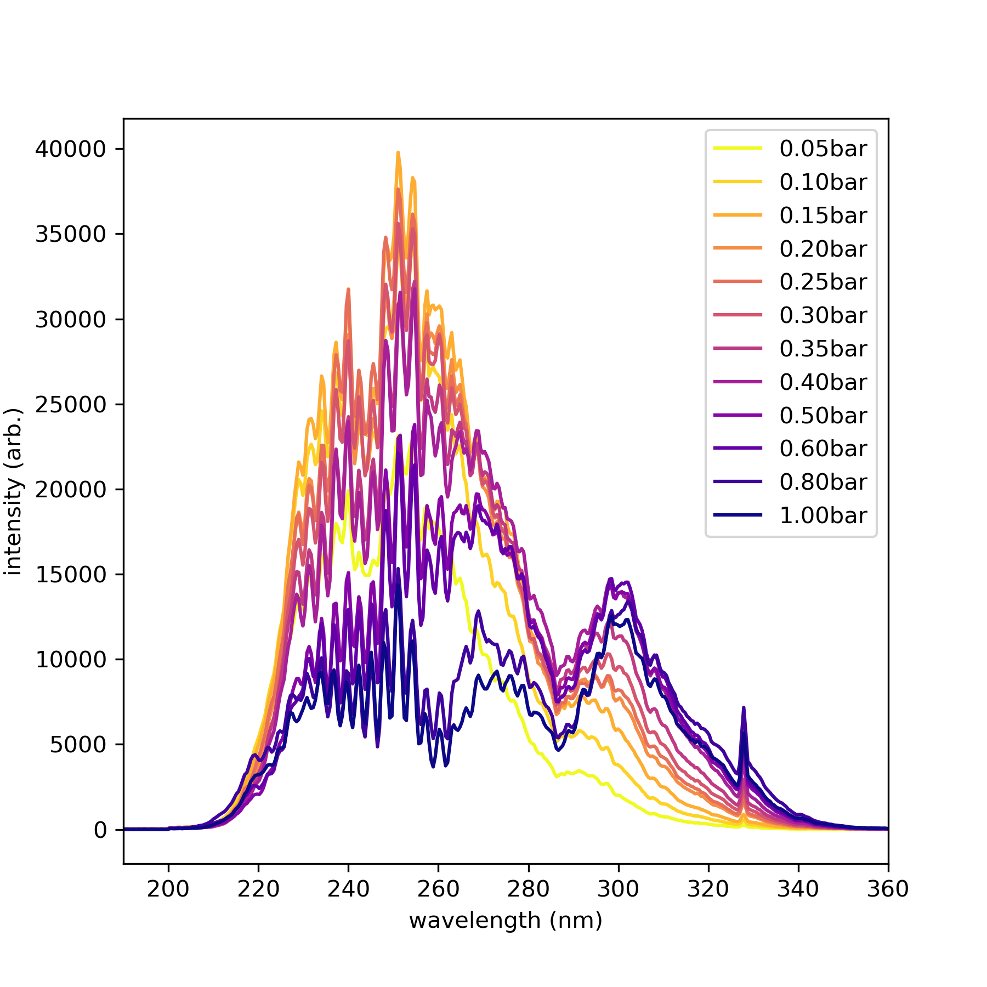
“Spectral breakdown”
Measured Argon spectrum at 300mW
At pressures beyond the saturation pressure, “spectral breakdown” can be observed experimentally
This involves a decrease in the 266nm TH peak and the appearance of new spectral peaks
These effects were reproduced by the simulations but, again, at much higher pressures

Slide 32
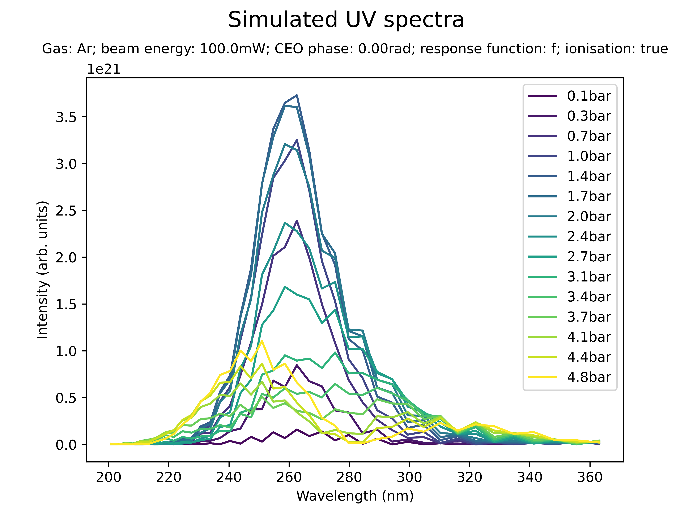
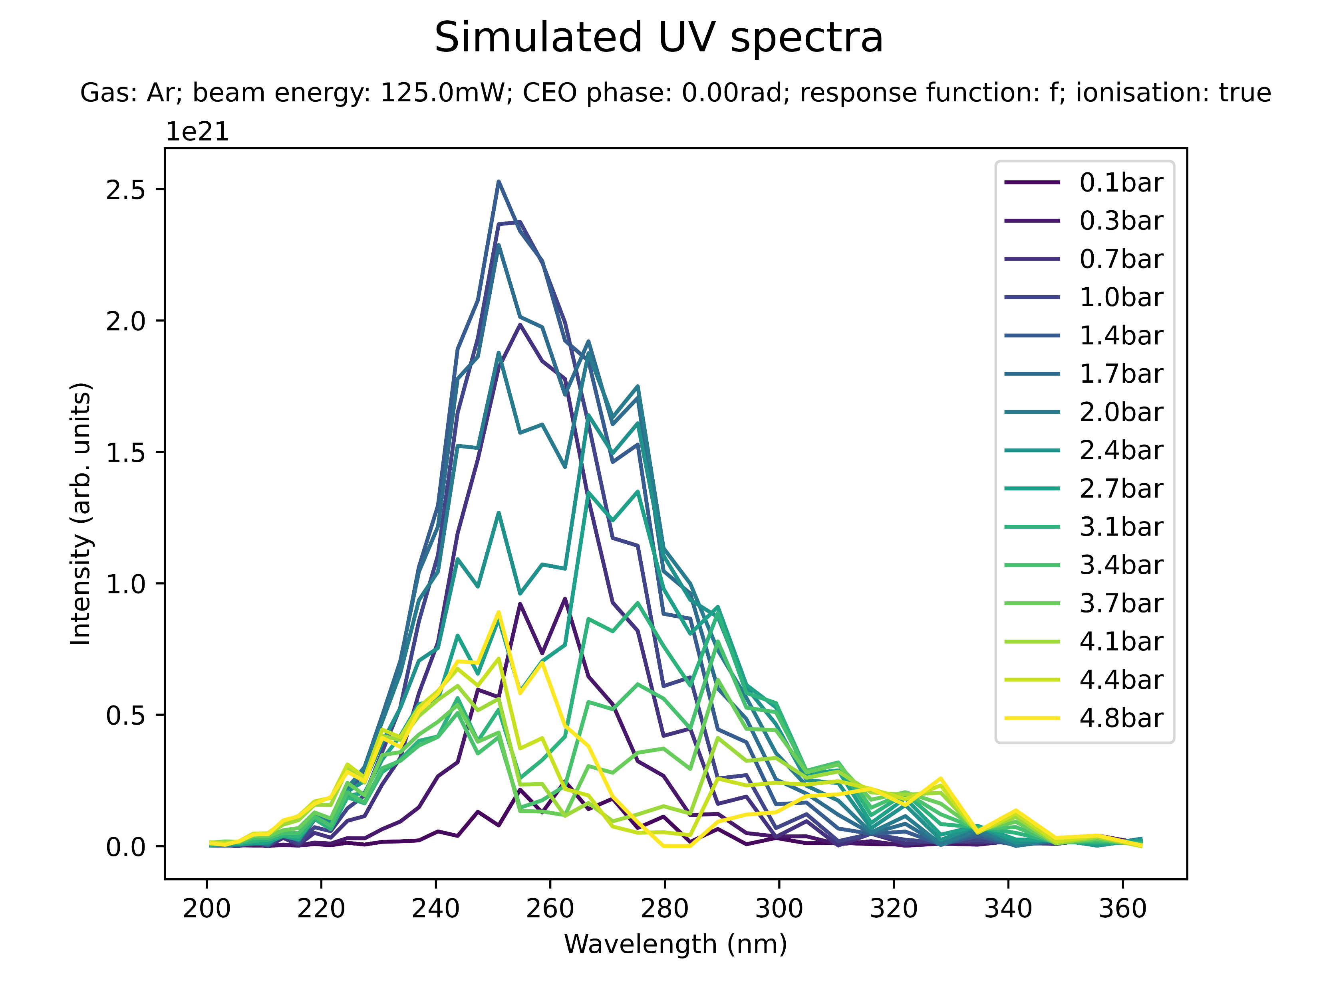
Effect of beam power on spectral profile (Ar)
Low power (Ar): blueshift with peak at 250nm

Slide 33
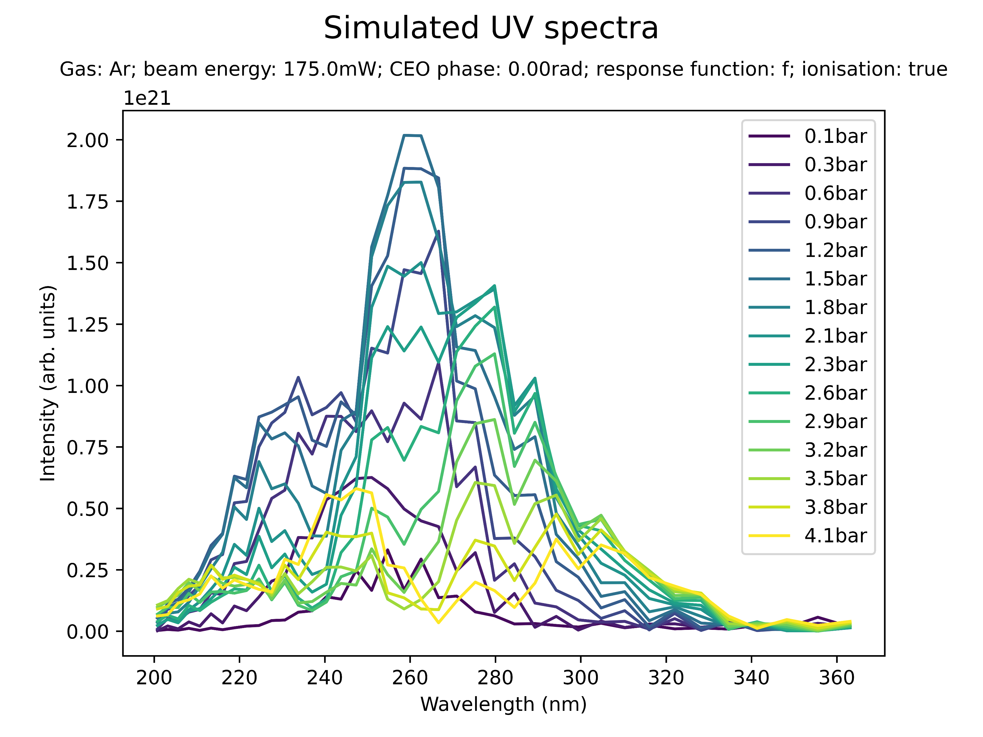
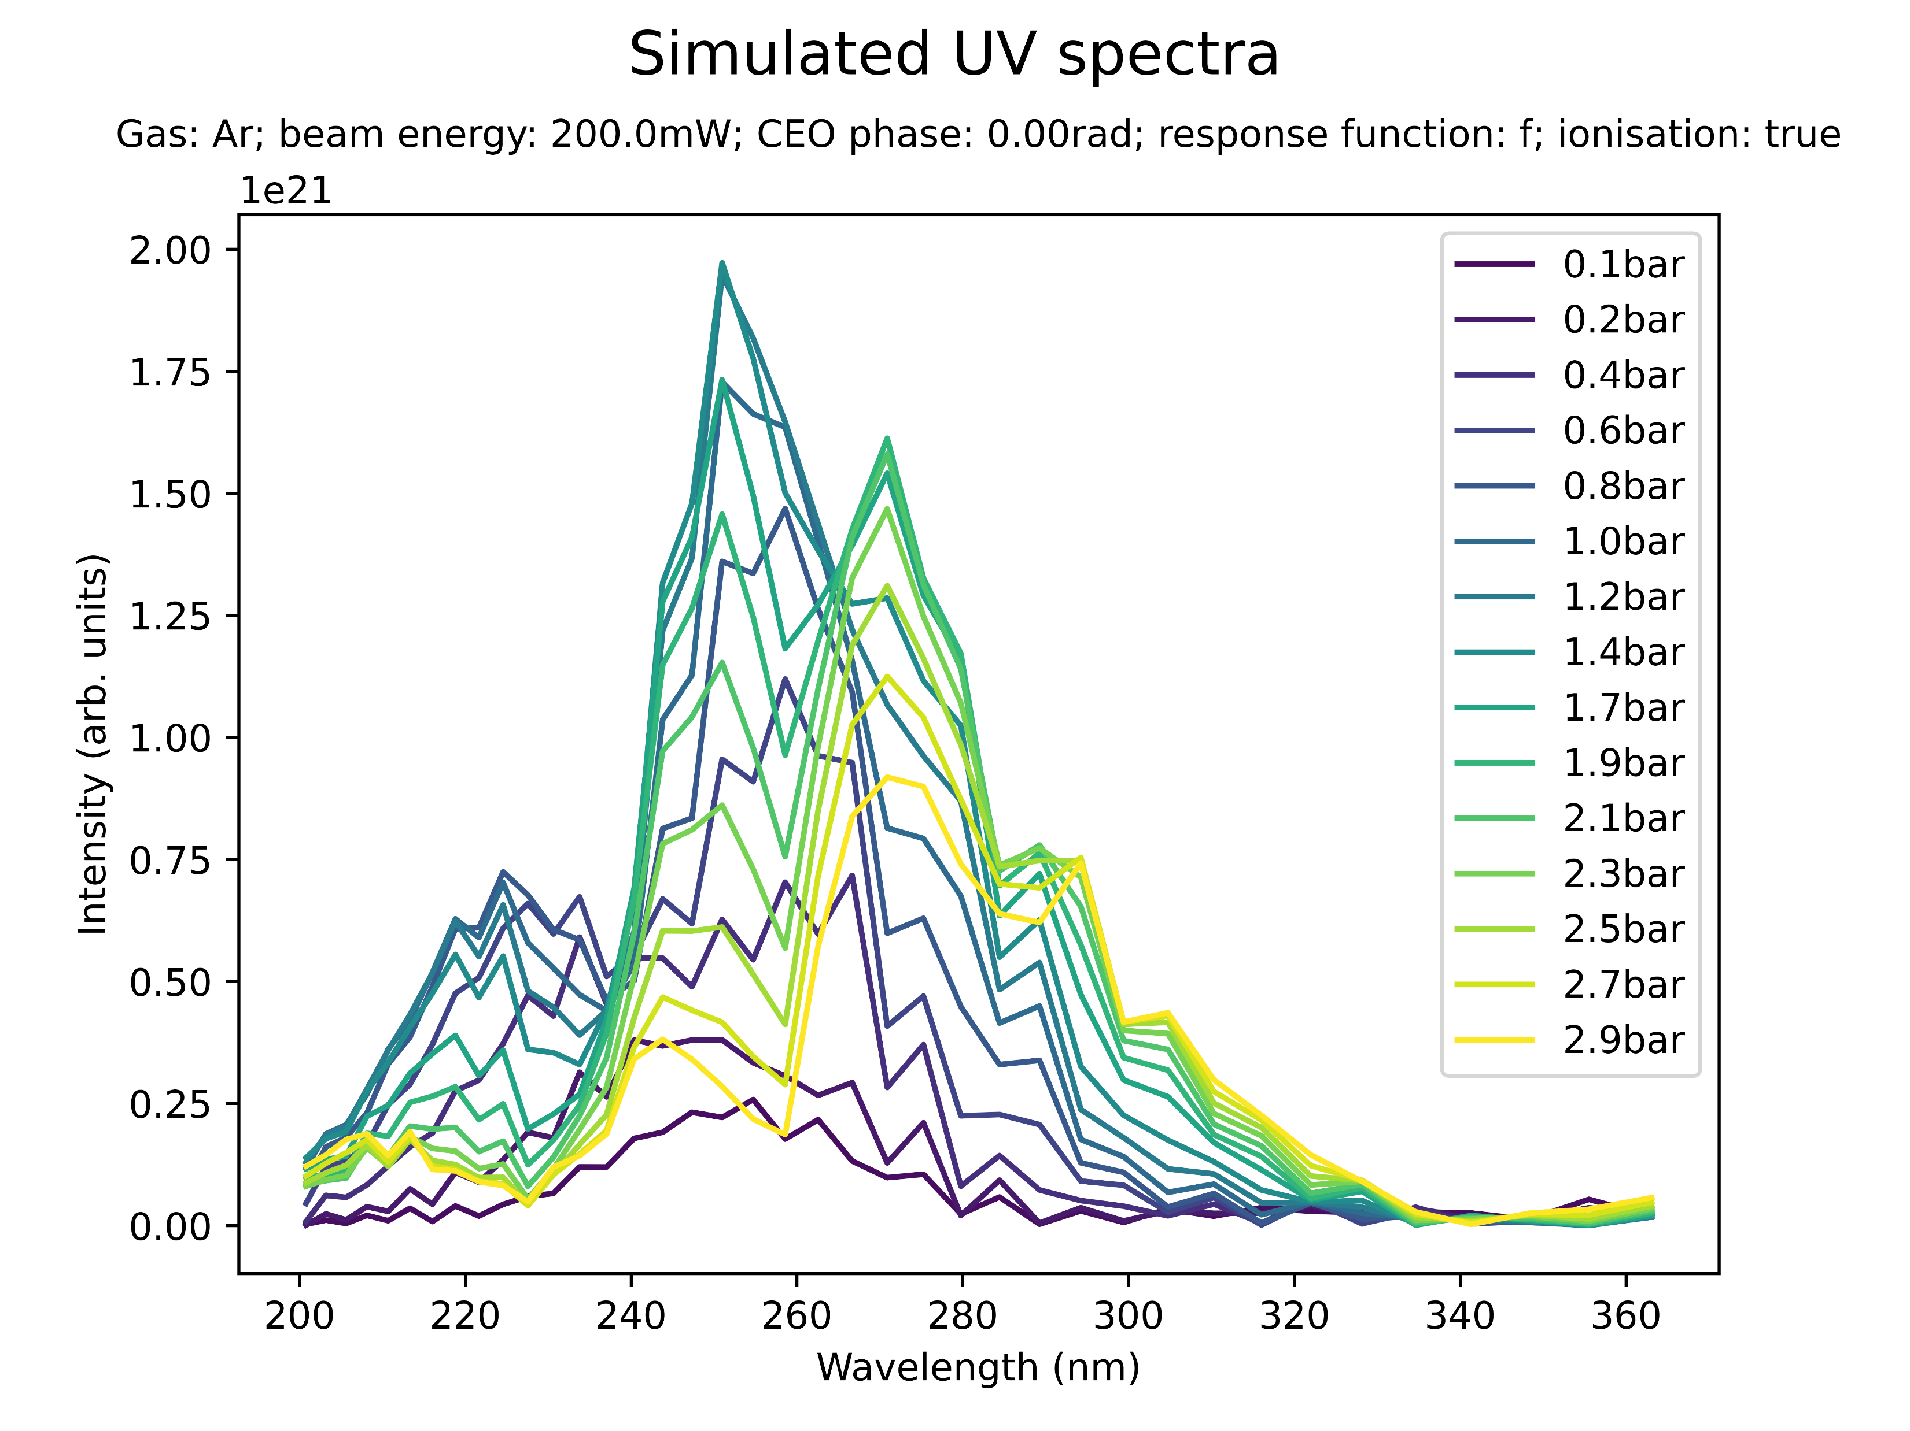
Effect of beam power on spectral profile (Ar)
Medium power (Ar): additional peaks at 230nm and 290nm

Slide 34
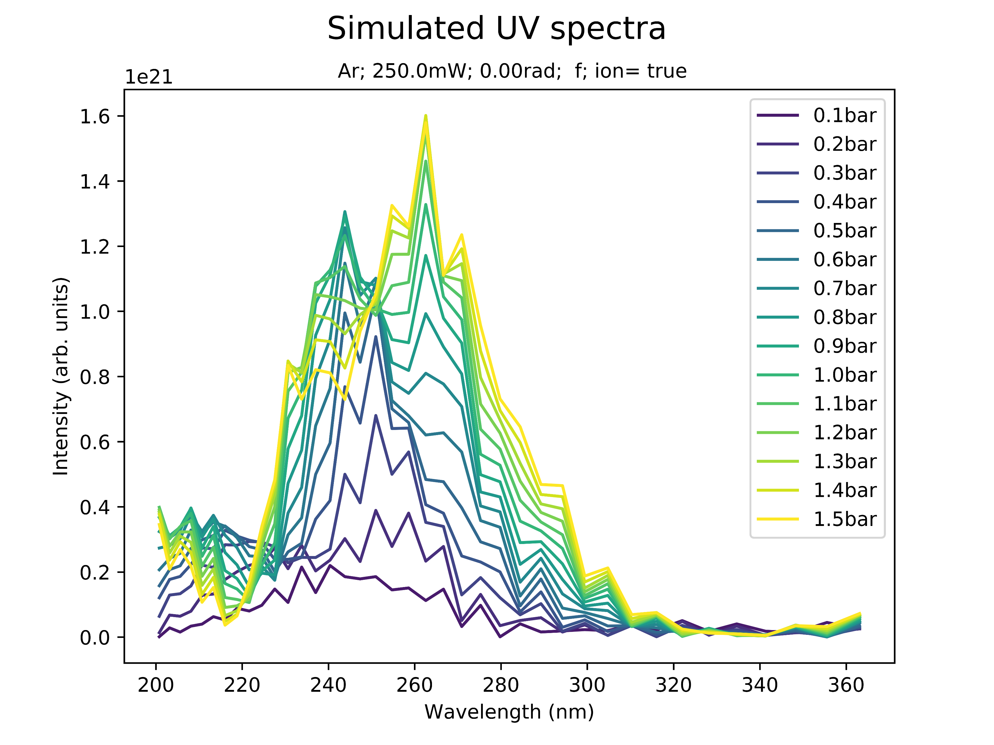
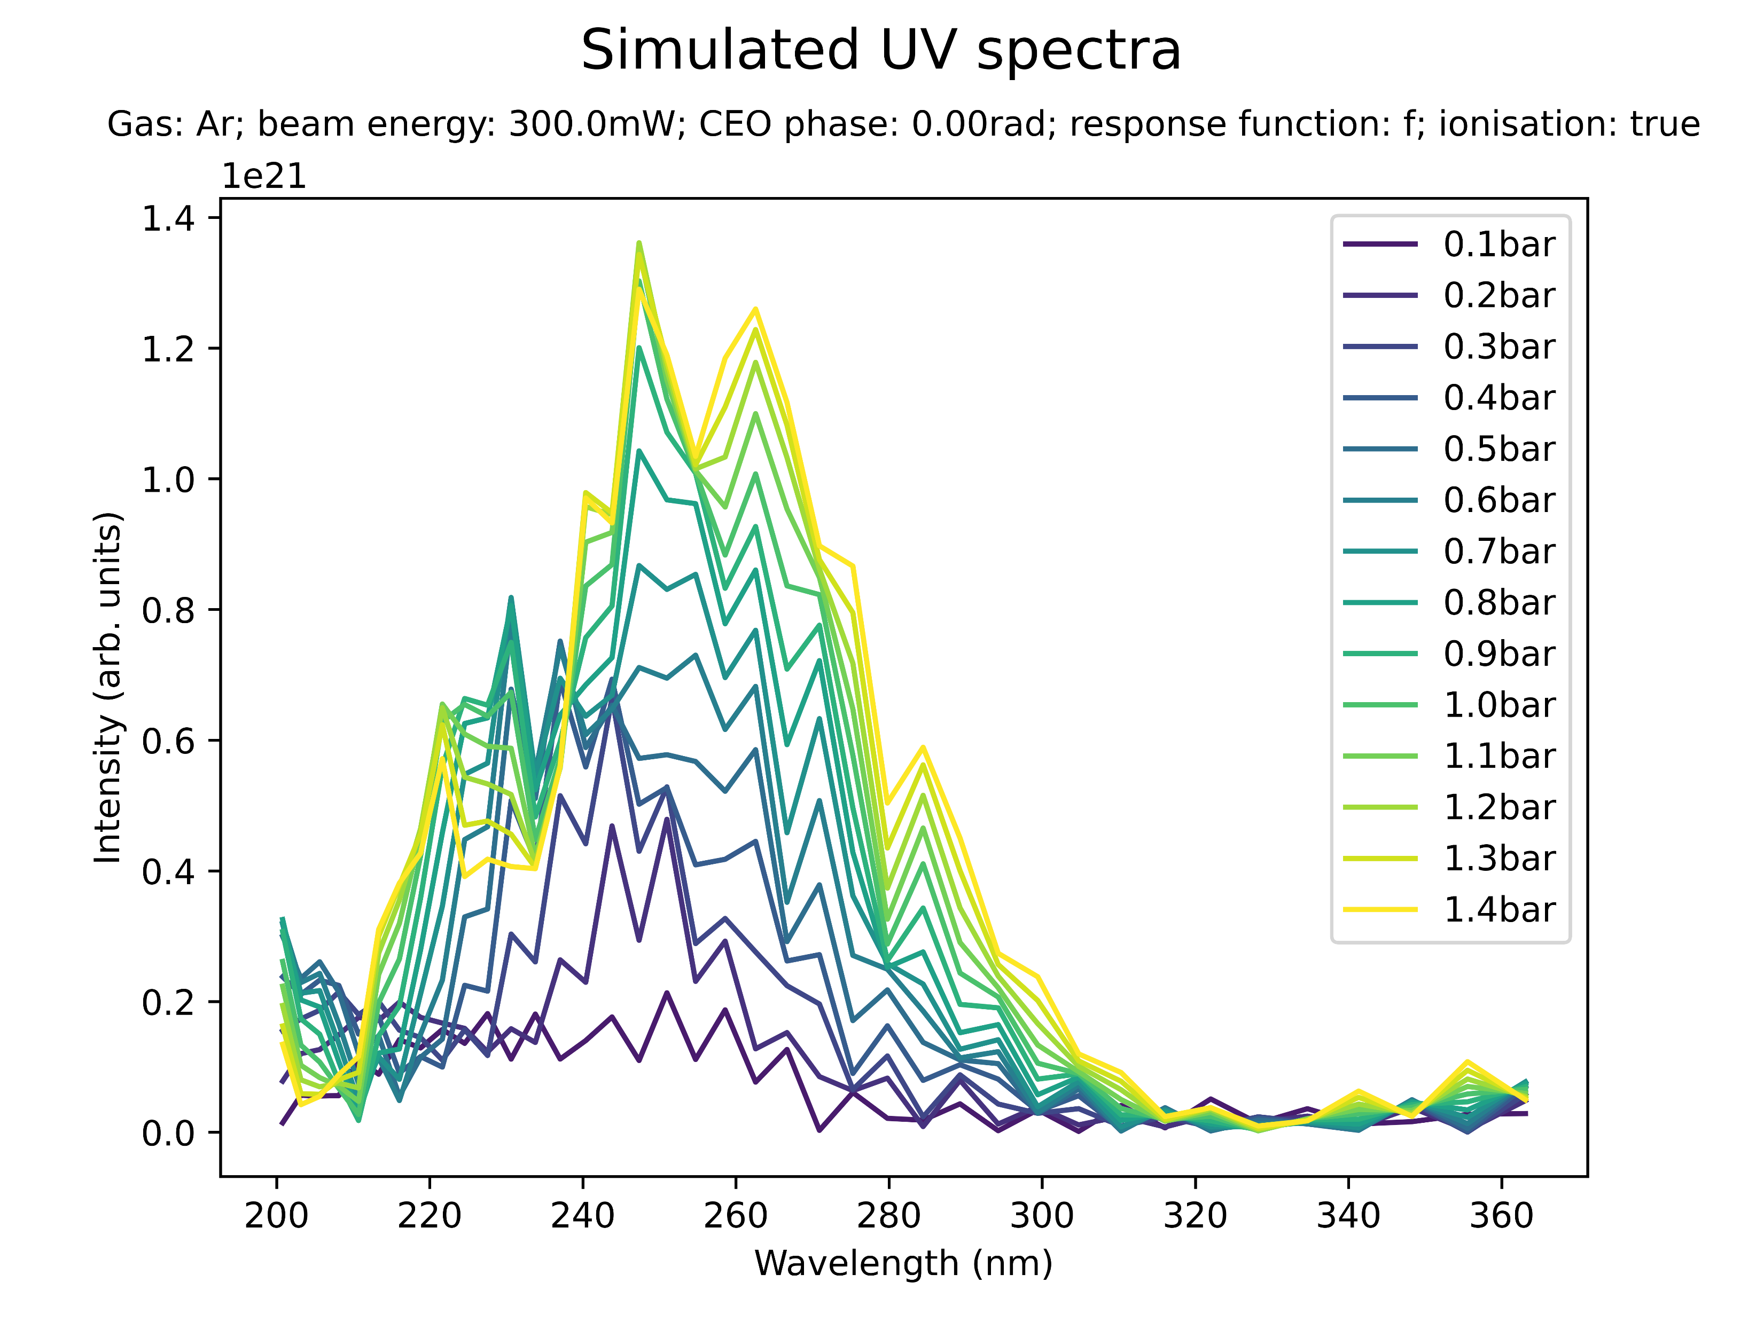
Effect of beam power on spectral profile (Ar)
High power (Ar): prominent peaks at 240nm; indication of sub-200nm peak

Slide 35
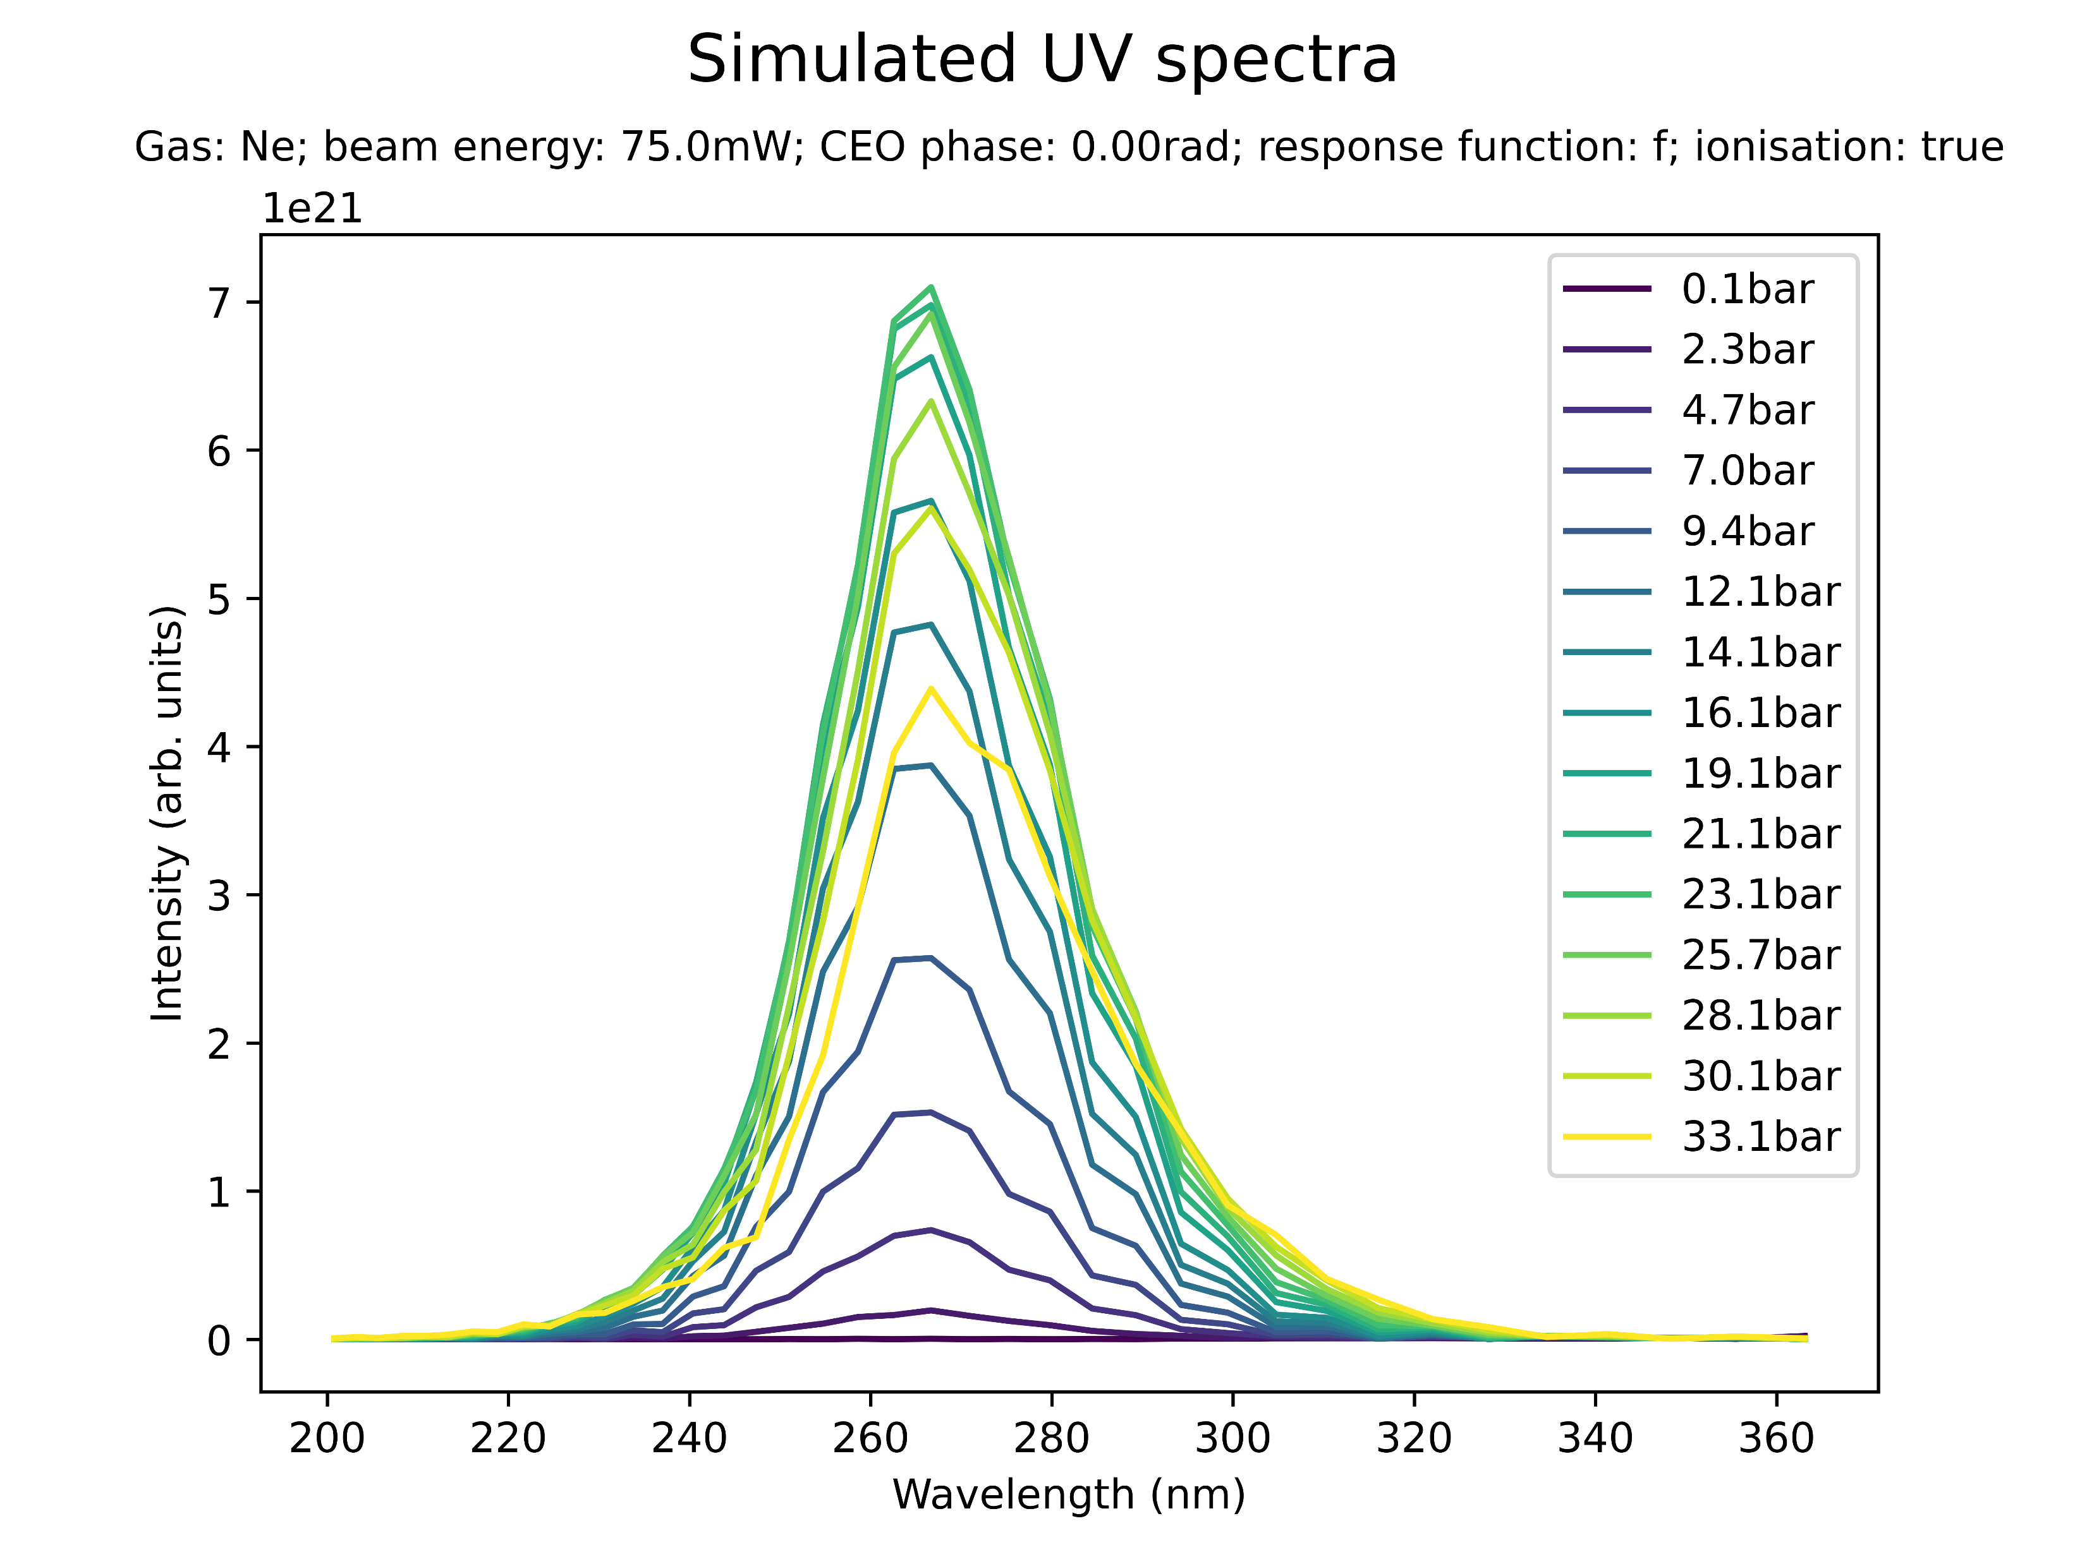
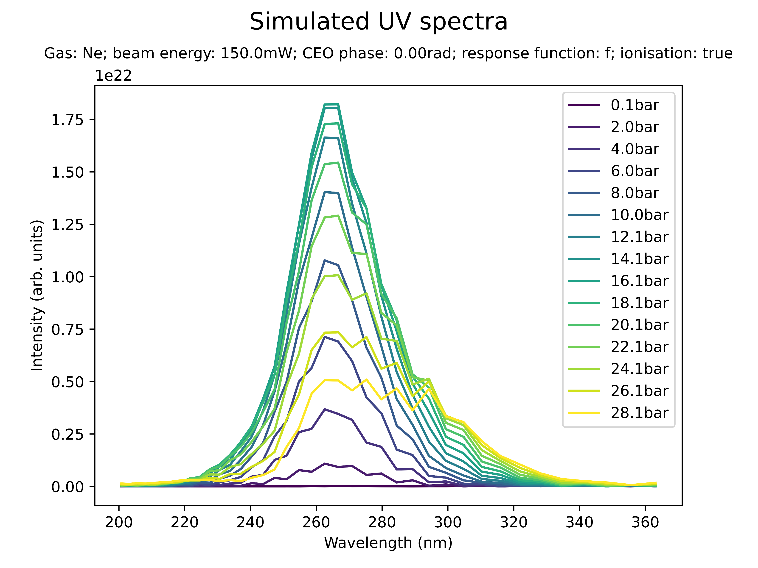
Effect of beam power on spectral profile (Ne)
Low power (Ne): redshift with peak at 290nm

Slide 36
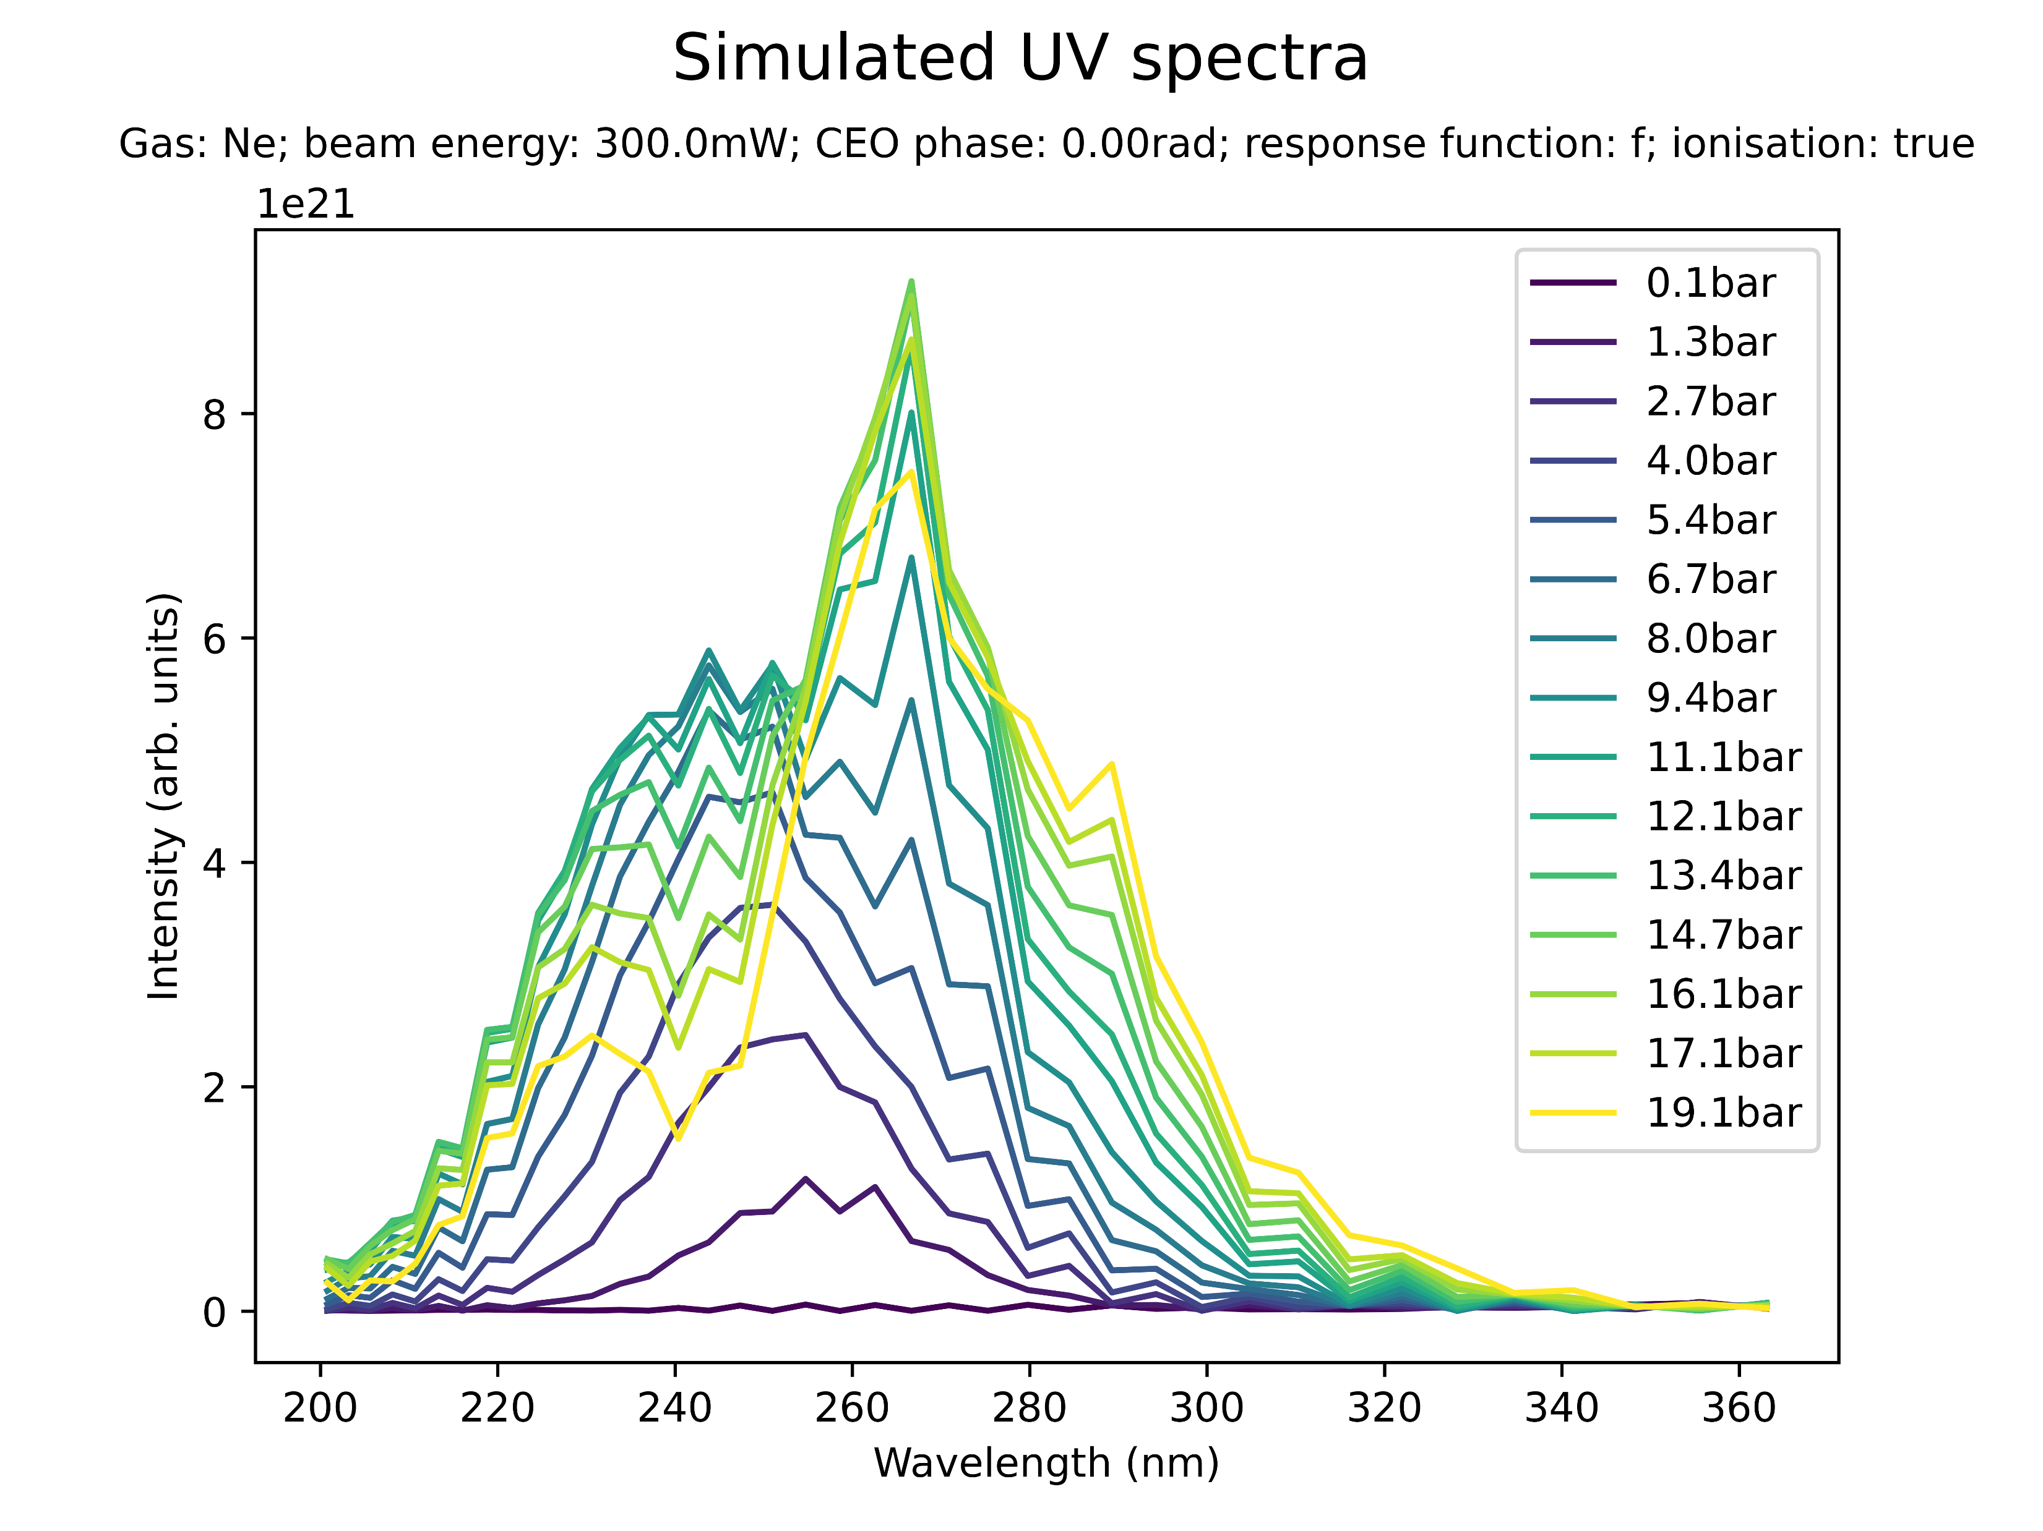

Effect of beam power on spectral profile (Ne)
High power (Ne): prominent peak at 250nm; indication of sub-200nm peak

Slide 37


Effect of CEO phase on spectral peaks
The CEO phase seems to have an impact on the spectral profile: no effect on overall shape but individual peaks are different

Slide 38


Effect of ionisation on spectral profile
no ion.
ion.
Low power (Ar): ionisation suppresses THG and the 230nm peak at high pressures

Slide 39


Effect of ionisation on spectral profile
no ion.
ion.
Medium power (Ar): ionisation significantly suppresses high-pressure peaks at 210nm and 300nm

Slide 40


Effect of ionisation on spectral profile
no ion.
ion.
High power (Ar): very significant peaks at 210nm (additionally: 250nm, 330nm)
Note: the simulations with ionisation break down at 1.5 bar

Slide 41
Summary: spectral profile
UV spectra are affected by “spectral breakdown” for most combinations of parameters at pressures exceeding the saturation pressure
Can the additional/vanishing spectral peaks be related to any known spectral lines or energy levels?
Ionisation seems to have a significant effect in suppressing spectral breakdown
There is no clear relationship between beam power and spectral profile at high pressures
The CEO phase seems to affect the presence of certain spectral peaks
Is this in contradiction to it being largely inconsequential for saturation?
Note: most of the above has been considered in isolation, with no cross-checking of parameter influences

Slide 42
III. BEAM PROFILE

Slide 43


Beam profile at low power (75mW Argon)
At saturation pressure (2.2 bar)
Beyond saturation pressure (4.8 bar)

Slide 44


Beam profile at medium power (150 mW Argon)
At saturation pressure (1.7 bar)
Beyond saturation pressure (5.0 bar)

Slide 45

Summary: beam profile
At the saturation pressure, the UV intensity peaks at the cell output
Beyond saturation, the UV intensity reaches a maximum within the cell and then decreases at the output
Related to coherence length/phase matching considerations?
Other nonlinear effects appear to take over, resulting in a “broken down” output spectrum?
150mW Argon
Beyond saturation pressure (5.0 bar)

Slide 46
IV. SELF-STEEPENING

Slide 47

Self-steepening
The simulation shows leading-edge self-steepening in the UV pulse
Also: trailing-edge self-steepening in the IR pulse
The following slides investigate self-steepening at saturation and after “breakdown”

Slide 48

Self-steepening
The simulation shows leading-edge self-steepening in the UV pulse
Also: trailing-edge self-steepening in the IR pulse
The following slides investigate self-steepening at saturation and after “breakdown”

Slide 49


Self-steepening at low power (75mW Argon)
At saturation pressure (2.2 bar)
Beyond saturation pressure (4.8 bar)

Slide 50


Self-steepening at low power (75mW Argon)
At saturation pressure (2.2 bar)
Beyond saturation pressure (4.8 bar)

Slide 51


Self-steepening at medium power (150mW Argon)
At saturation pressure (1.7 bar)
Beyond saturation pressure (5.0 bar)

Slide 52


Self-steepening at medium power (150mW Argon)
At saturation pressure (1.7 bar)
Beyond saturation pressure (5.0 bar)

Slide 53
Summary: self-steepening
The trailing-edge self-steepening of the IR pulse persists at pressures beyond the saturation pressure
The UV pulse leading-edge self-steepening seems to subside at “breakdown”
Compare with role of self-steepening in the THG process reported in the literature (e.g., Reiter 2010)

Slide 54
Conclusion & Next Steps

Slide 55
Conclusion & next steps
Start working with COMSOL
export & test existing density simulations
try to improve existing simulations/expand to the high-pressure regime?
Analyse the open questions posed throughout these slides
Compare simulations with literature and experiments
Find explanations for the observed effects
Focus on a few key questions to investigate in more detail

Slide 56
THG Simulations
Project update: follow-up
Week 3B
11/08/2023
David Amorim

Slide 57

Comparison of spectra
IR spectrum calculated from FROG largely agrees with IR spectrum measured by spectrometer
The shape of the spectra also agree with the simulated IR spectrum (grey)
However, the measured spectra are centred around 730nm, not 800nm
Set the central wavelength to 730nm in the simulations?

Slide 58

Reproducing plots from Reiter et al. 2010
In Reiter: spatiotemporal evolution shows leading-edge self-steepening in UV and trailing-edge in IR
In Reiter: removing ionisation suppresses self-steepening and elongates pulse
Parameters: 300μJ IR pulse centred on 750nm incident on Neon cell with 9.0bar central pressure
This system was simulated, comparing the ionised and non-ionised case
IR
UV
UV
Reiter 2010

Slide 59




Reproducing plots from Reiter et al. 2010
With ionisation
Without ionisation

Slide 60




Reproducing plots from Reiter et al. 2010
With ionisation
Without ionisation

Slide 61




Reproducing plots from Reiter et al. 2010
With ionisation
Without ionisation

Slide 62




Reproducing plots from Reiter et al. 2010
With ionisation
Without ionisation

Slide 63

Reproducing plots from Reiter et al. 2010
Simulations show very clear trailing-edge self-steepening in the IR pulse and the UV pulse
Turning off ionisation mostly suppresses this effect and increases the pulse duration
The simulations could not reproduce the core features of Reiter
Is there something fundamentally wrong with the model?
Reiter 2010 (UV; with ionisation)

Slide 64
List items for discussion with Chris (Luna)
Lacking documentation for Nonlinear.jl response functions
in particular: how do KerrField, PlasmaCumtrapz, etc. relate to specific terms in the UPPE?
Extracting temporal/spectral phase information
Breakdown in PlasmaScalar! Ionisation function
Note: potential fix using ADK ionisation instead of PPT
Spatial grids with centring on zero?
Current problem with COMSOL implementation

Slide 65
Position of beam focus
Changing the beam focus position seems to affect a wide variety of pulse parameters:
output pulse duration
spatiotemporal pulse profile
total pulse energy
…
So far, only cursory exploration (see next slides)
Worthwhile to investigate further?

Slide 66



Position of beam focus
Shift by zr to the left
Centred focus
Shift by zr to the right

Slide 67



Position of beam focus
Shift by zr to the left
Centred focus
Shift by zr to the right

Slide 68



Position of beam focus
Shift by zr to the left
Centred focus
Shift by zr to the right

Slide 69



Position of beam focus
Shift by zr to the left
Centred focus
Shift by zr to the right

Slide 70



Position of beam focus
Shift by zr to the left
Centred focus
Shift by zr to the right

Slide 71
Next steps?
Check different gases
Use COMSOL density funcs
Re-do plots with experimental data overlayed

Slide 72
Relative Neon/Argon saturation values [OLD]
Beam power* | Beam peak intensity** | E_Ne/E_Ar † | P_Ne/P_Ar ‡
75mW | 0.091 PW/cm^2 | 0.945 | 11.591
150mW | 0.182 PW/cm^2 | 2.302 | 11.588
200mW | 0.243 PW/cm^2 | 2.871 | 10.688
300mW | 0.365 PW/cm^2 | 3.376 | 10.143
* Based on a 1kHz pump beam repetition rate
** Peak 1/$e^{2}$ intensity for a 65 µm beam waist and 6.2fs pulse duration
† Saturation UV energies
‡ Saturation pressures
Note: the simulations included ionisation; the CEO phase was set to zero and the beam focus was located at the centre of the 3mm cell; a simple gradient approximation with edge pressure 1mbar was used

Slide 73

Comparison of different gases [OLD]
At the given parameter values, the highest UV energies are generated by krypton, argon and nitrous oxide
Investigate Kr and N2O in more detail (plots on Sync&Share)?
Neon, on the other hand, yields the second-lowest UV energy
Note that relative gas performance is likely sensitive to central gas pressure and beam power: simulations should be extended!

Slide 74
THG Simulations
Project update
Week 5
18/08/2023
David Amorim

Slide 75
Simulations
An extensive round of parameter scans was carried out, involving over 5000 simulation runs and the following parameters:
gases: Ar, Ne, Kr, Xe, He, N2, and N2O
beam powers: 75mW, 150mW, 200mW, 300mW, and 400mW
pressures: 0.1bar to 5.1bar in 0.1bar increments
density profiles: gradient and COMSOL
The scan outputs consisted of:
total UV energy & efficiency
UV pulse duration
UV output spectrum
Position of the UV energy peak
Caveats: the simulations used the ADK ionisation model instead of PPT; at the time of writing, the simulations have not yet finished!

Slide 76
Overview
Comparison of the two density models
Compare the profiles themselves
Show general results of pressure scan comparisons
In-depth case study
Comparison of the different gases
Energy saturation and peak energies
Pulse durations
Selection of “conditions of interest” (combinations of pressure, beam power, and gas that result in >100nJ sub-2fs UV pulses)
Next steps

Slide 77
I. COMSOL V. GRADIENT

Slide 78

The density profiles
The gradient profile has a higher peak and steeper drop-off than COMSOL
This difference is (qualitatively) unchanged when varying the pressure
Most importantly but not shown here: COMSOL also includes the region outside the cell (3.5cm on either side)
Overall, fairly good agreement of the two models within the cell

Slide 79

The density profiles
The COMSOL simulations are only based on Argon
However, at the given pressures there is barely any difference in the density profiles of various gases
Thus, the COMSOL model was also applied to the other gases in the parameter scans
Note: the COMSOL data used here was not generated with the improved high-Mach model!

Slide 80


Pressure scan comparisons
The COMSOL and gradient models were compared in a variety of pressure scans
Across all beam powers and pressures, COMSOL predicts a significantly lower UV energy output
Exception: N2O at 300mW?!
There is also generally disagreement between the simulated pulse duration, although without a clear pattern
Note: FWHM pulse durations are used, which are sensitive to pulse shape and hence could be misleading
Note: the plots above are random examples and not related

Slide 81


Case study: Argon at 1.0bar with 150mW
COMSOL
gradient

Slide 82


Case study: Argon at 1.0bar with 150mW
COMSOL
gradient

Slide 83


Case study : Argon at 1.0bar with 150mW
COMSOL
gradient

Slide 84


Case study: Argon at 1.0bar with 150mW
COMSOL
gradient

Slide 85


Case study: Argon at 1.0bar with 150mW
COMSOL
gradient

Slide 86


Case study: Argon at 1.0bar with 150mW
COMSOL
gradient

Slide 87


Case study: Argon at 1.0bar with 150mW
COMSOL
gradient

Slide 88


Case study: Argon at 1.0bar with 150mW
COMSOL
gradient

Slide 89


Case study: Argon at 1.0bar with 150mW
COMSOL
gradient

Slide 90


Case study: Argon at 1.0bar with 150mW
COMSOL
gradient

Slide 91


Case study: Argon at 1.0bar with 150mW
COMSOL
gradient

Slide 92


Case study: Argon at 1.0bar with 150mW
COMSOL
gradient

Slide 93
Conclusions
Despite the relatively good agreement of the gradient and COMSOL models within the cell, the simulation output is drastically different
Apart from the scale of the UV output energy, the gradient model seems to produce results that agree more closely with the expected and measured pulse properties
The relevant factor appears to be the propagation of the pulse outside the cell, which is neglected in the gradient model
Compare gradient model to a truncated COMSOL model involving only the cell itself?
Investigate propagation of the pulse before and after the cell? (see next slide)

Slide 94


Side note: position of the UV maximum
A possible way to investigate the behaviour outside the cell is to consider where the maximum UV energy is measured
This is probably closely linked to saturation effects

Slide 95
II. GAS COMPARISONS

Slide 96
Energy saturation
The table below indicates whether UV energy saturation sets in at the given pressure range (0.1bar to 5.1bar) powers
Thus, there are four saturable gases (Ar, Kr, N2, N2O) and three non-saturable gases (Ne, He, Xe)
For non-saturable gases: benefit in increasing pressure further!
Beam power | Ar | Ne | He | Kr | Xe | N2 | N2O
75mW | Y | N | N | Y | N? | Y | Y
150mW | Y | N | N | Y | N? | Y | Y
200mW | Y | N | N | Y | N? | Y | Y
300mW | Y | N | N | Y | N? | Y | Y
400mW | Y | N? | N | Y | N? | Y | Y?
Y: yes for both models; N: no for both models; Y/?N?: yes/no for COMSOL, as of yet unknown for grad

Slide 97

Peak energies
Notes:
due to unfinished scans the energies of the non-saturable gases might be underestimated
the gradient model data is not fully available yet but qualitatively agrees, although at much higher energies
THG in Xe and N2O is significantly more powerful than in the other gases
He and Ne are particularly weak
Peak energies could be further increased by increasing beam power and the central pressure

Slide 98





Pulse energies: extra detail
The purpose of these plots is mainly to indicate that the peak energy is a good indicator of the energy across different pressures

Slide 99

Pulse durations
Notes:
due to unfinished scans some minimal pulse durations might be overestimated
comparable data for the gradient model is still being simulated
this plot could be misleading (see below and next slide)!
There is a clear pattern of He and Ne consistently achieving the shorted pulses across all pressures for different beam powers, with N2, Ar and Kr forming a middle ground and N2O performing the worst
But: the plot shows the minimum pulse duration across all pressures and includes potentially not significant low-energetic UV fluctuations at low pressures

Slide 100





Pulse durations
These plots serve to show that the relationship between pulse duration, pressure, beam power and gases is non-trivial and not captured well by the minimum pulse duration

Slide 101
III. CONDITIONS OF INTEREST

Slide 102
Conditions of interest
The previous section showed the complex relationship between gas type, beam power, gas pressure, pulse duration and pulse energy
From what was seen it is difficult to work out general rules and patterns for ideal THG conditions (short but energetic pulses)
For this reason, a set of promising conditions was identified manually based on the simulation output
Not a very rigorous process! Involved many estimates…
Note that both COMSOL and gradient-based data was considered, although the former rarely predicted suitable conditions

Slide 103
Conditions of interest: table (1/2)
The following table shows parameter combinations which are predicted to result in energetic (>100nJ) and short (sub-2fs) UV pulses
Gas | Beam power | Pressure | Density model | Pred. duration | Pred. energy
Ne | 400mW | 0.1-2.5bar | grad | 0.5-0.8fs | 100-800nJ
He | 400mW | 2.0-4.0bar | grad | 0.8fs | 500-1500nJ
Ar | 300mW | 2.5-4.0bar | grad | 1.1-1.5fs | 800-1000nJ
Xe | 300mW | 1.5-2.5bar | COMSOL | 0.7-1.1fs | 500-700nJ
He | 300mW | 2.0-5.0bar | grad | 0.6-1.0fs | 300-1400nJ
Ar | 300mW | 3.5-4.0bar | grad | 1.2fs | 800nJ
Ne | 300mW | 1.0-5.0bar | grad | 0.7-1.0fs | 500-2500nJ
N2 | 200mW | 3.0-5.0bar | grad | 1.5-1.9fs | 400-450nJ

Slide 104
Conditions of interest: table (2/2)
The following table shows parameter combinations which are predicted to result in energetic (>100nJ) and short (sub-2fs) UV pulses
Gas | Beam power | Pressure | Density model | Pred. duration | Pred. energy
N2O | 200mW | 3.5-5.0bar | grad | 1.1-1.3fs | 700-900nJ
Kr | 200mW | 1.5-3.0bar | grad | 1.3-1.5fs | 500-600nJ
He | 200mW | 3.0-5.0bar | grad | 0.5-1.1fs | 200-450nJ
Xe | 150mW | 0.8-2.0bar | grad | 1.5-1.9fs | 300-500nJ
N2O | 150mW | 3.5-5.0bar | grad | 0.8-1.3fs | 600-800nJ
Kr | 150mW | 1.5-2.5bar | grad | 1.3-1.5fs | 400-500nJ
He | 150mW | 4.5-5.0bar | grad | 1.1-1.2fs | 130-200nJ
N2 | 150mW | 4.0-5.0bar | grad | 1.6-1.9fs | 400-450nJ
Ne | 150mW | 2.1-5.0bar | grad | 0.7-1.1fs | 150-500nJ

Slide 105
IV. NEXT STEPS

Slide 106
Next steps?
Investigate some “conditions of interest” in more detail?
Ideally could find something useful or make predictions for next week’s experiments?
Implement beam chirp and carry out chirp scan?
Investigate the effects of parameters like the beam waist and beam focus?
Analyse the scan data in more detail and with the full data?
Compare spectra?!
Run scans with the PPT ionisation model instead?
Investigate effect of pulse propagation outside the cell?

Slide 107
THG Simulations
Project update
Week 6
??/08/2023
David Amorim

Slide 108
I. EFFECTS OF CHIRP

Slide 109
Effects of chirp
The following slides show what happens when positive or negative chirp is added to the input pulse
This was done by adding a GVD of $±$11.31fs² and comparing to the case without GVD
The chosen GVD value corresponds to a 6.2fs TL pulse being stretched to 8.0fs
Neon at 5.0bar and 400mW was considered, for both density models
The UV pulse duration and spectrum are shown

Slide 110



Effects of chirp: both models
+ve chirp
no chirp
-ve chirp

Slide 111



Effects of chirp: gradient model
+ve chirp
no chirp
-ve chirp

Slide 112



Effects of chirp: gradient model
+ve chirp
no chirp
-ve chirp

Slide 113



Effects of chirp: COMSOL model
+ve chirp
no chirp
-ve chirp

Slide 114



Effects of chirp: COMSOL model
+ve chirp
no chirp
-ve chirp

Slide 115
Effects of chirp: conclusion
Introducing chirp results in shorter pulses in both the COMSOL and gradient models
negative chirp seems to produce slightly shorter pulses than positive chirp
in the COMSOL model, chirp significantly deforms the UV output beam
In the gradient model, negative chirp increases UV intensity and narrows the spectrum around the THG peak while positive chirp increases a second peak
In the COMSOL model, chirp mainly introduces smaller additional peaks while diminishing the THG peak
Chirp definitely has some effect; investigate this more?

Slide 116
II. GAS COMPARISON (UPDATED)

Slide 117
Energy saturation (updated)
The table below indicates whether UV energy saturation sets in at the given pressure range (0.1bar to 5.1bar) powers
Thus, there are six saturable gases (Ar, Kr, N2, N2O, O2, SF6) and three non-saturable gases (Ne, He, Xe)
For non-saturable gases: benefit in increasing pressure further!
Beam power | Ar | Ne | He | Kr | Xe | N2 | N2O | O2 | SF6
75mW | Y | N | N | Y | N | Y | Y | Y | Y
150mW | Y | N | N | Y | N | Y | Y | Y | Y
200mW | Y | N | N | Y | N | Y | Y | Y | Y
300mW | Y | N | N | Y | N | Y | Y | Y | Y
400mW | Y | N | N | Y | N | Y | Y | Y | Y
Y: yes for both models; N: no for both models

Slide 118


Peak energies (updated)

Slide 119


Pulse durations (updated)

Slide 120
Conclusions (updated)
(Note: see Week 5 presentation for comments on the types of plots just shown)
The COMSOL and gradient models differ significantly in their predictions for both the shortest pulse durations and the highest UV energies
UV energies:
The COMSOL model shows Xe and N2O dominating at high beam powers, with Ne and He as the gases with the weakest UV energies
The gradient model also shows Xe dominating but with Ne, He, Kr, and Ar overtaking N2O at high beam powers
Pulse durations:
Both models agree on He and Ne producing the shortest pulses and on Ar being somewhat average

Slide 121
III. QUESTIONS & NEXT STEPS

Slide 122
Next steps
Decide which simulations to run and plots to produce for manuscript and report (“final runs”) [see next slide]
Ideally (necessarily?) with improved high-Mach COMSOL models
Prepare code for final runs while waiting for new COMSOL data
Rewrite code and prepare handover document
PowerPoint on GitHub (still work in progress)
Schedule meeting for handover?
Work on report and presentation
To save time/prioritise: base report and presentation on results for manuscript
Questions: length of presentation, level of background required, formality…?

Slide 123
“Final runs” (?)
To demonstrate agreement between experiment & simulations:
Compare simulated and measured spectra [selected case(s)]
Compare simulated and measured pressure scan UV energy [selected cases]
use optimal conditions (PPT, updated COMSOL model…)
To demonstrate which processes affect THG/beam:
Show self-steepening in spatio-temporal beam profile [with/without ionisation for comparison]
Compare old cell and new chip [if COMSOL data exists]:
Spectra, energies, UV energies as functions of propagation distance
Show different density profiles
To demonstrate which additional parameters might be relevant:
Investigate chirp, CEP, in small parameter scan?

Slide 124
THG Simulations
Project update
Week 7
29/08/2023
David Amorim

Slide 125
Overview
Work done since last week:
Finished code handover document (meeting this Friday at 11am?)
Set up code to use for manuscript plots
Work left to do:
Produce plots for manuscript with the improved COMSOL model (for both the new and the 2019 cell)
Write presentation and report (based on manuscript plots)
This presentation:
Showing preliminary sample plots for the manuscript, produced using the old density models
Produced only for Argon; for manuscript: do Argon and Neon (?)
Please give feedback on anything to be changed for the plots (e.g. labels, annotations, fontsizes,….)

Slide 126


Sample manuscript plots: A. Simulated pressure scan energies
NORMALISE ENERGIES; RESCALE PRESSURES
Fig. 1a: Argon at 150mW (simulations with
COMSOL model)
Fig. 1b: Argon at 150mW (simulations with
gradient model)

Slide 127


Sample manuscript plots: B. Simulated v. measured UV spectra
Use rescaled pressure; have spectra start at 200!
Fig. 2a: Argon at 150mW and 0.4bar (simulations with
gradient model)
Fig. 2b: Argon at 150mW and 0.4bar (simulations with
COMSOL model)

Slide 128

Sample manuscript plots: C. New chip v. old cell
Note: no model of old chip available yet
Fig. 3: Argon at 150mW and 0.4bar (simulations with
gradient model and COMSOL model of new chip)

Slide 129


Sample manuscript plots: D. Spatiotemporal UV profile at output
SHOW TIMING DATA
Note: add TL pulse duration as annotation?
(a) with ionisation
(b) without ionisation
Fig. 4: Argon at 150mW and 0.4bar (simulations with
gradient model)

Slide 130

Sample manuscript plots: E. Spatiotemporal UV profile at different positions
Fig. 5: Argon at 150mW and 0.4bar (simulations with
gradient model)

Slide 131

Sample manuscript plots: F. Effects of chirp
Note: add TL pulse duration as annotation?
Fig. 6: Argon at 150mW and 0.4bar with different
GVD values of the input pulse (simulations with
gradient model)

Slide 132

Sample manuscript plots: G. Effects of CEP
IGNORE
Fig. 7: Argon at 150mW and 0.4bar with different CEP values of the input pulse (simulations with
gradient model)

Slide 133
Sample manuscript plots: H. Comparison of 10 best spectra
no time yet
Note: is it even worth it?
Fig. 8: ….

Slide 134



Sample manuscript plots: I. New: 2d maps
Fig. 9a: Argon at 150mW (simulations with
gradient model)
Fig. 9b: Argon at 150mW (measured)

Slide 135



Sample manuscript plots: I. New: 2d maps
Fig. 9c: Neon at 400mW (simulations with
gradient model)
Fig. 9d: Neon at 400mW (measured)

Slide 136
Questions
Feedback for plots?
Where to find images of old and new gas cell/chip (for report and presentation)?
COMSOL…

Slide 137
THG Simulations
Project update
Week 8
05/09/2023
David Amorim

Slide 138


Spectral phase UV
Argon; 0.4bar (rescaled); 150mW

Slide 139

Spectral phase IR
Argon; 0.4bar (rescaled); 150mW

Slide 140



Spectrally-resolved time profile
GVD=-11fs^2
GVD=0
GVD=+11fs^2
Argon; 0.4bar (rescaled); 150mW

Slide 141

Spectrally-resolved time profile
ionisation
no ionisation
Argon; 0.4bar (rescaled); 150mW

Slide 142


Neon self-defocusing
1.0 bar
6.0 bar
Neon; rescaled pressures; 400mW

Slide 143
Admin
Submitted report
Final meeting with Francesca today
Will return access cards and transducer to Patricia on Thursday
IT access should be retained until 30 September (?), can use my university’s cluster to run the simulations if not

Slide 144

Modelling of nonlinear light up-conversion from intense femtosecond laser pulses
DESY Summer Student Programme 2023
Project Presentation
Group: CFEL-ATTO
Supervisor: Josina Hahne
David Amorim (University of Glasgow)

Slide 145


1. Motivation
The CFEL-ATTO group uses THG of few-femtosecond NIR laser pulses in a gas cell to generate ultrashort UV pulses
The aim of this project was to produce simulations of the THG process to:
Reproduce the experimental conditions in the gas
Study the effects and parameters shaping UV generation
Compare the new gas chip to the old (2019) gas cell
Fig. 1: the fused silica chip used for gas confinement. Reproduced from Josina Hahne’s master’s thesis defence

Slide 146




2. Background
The simulations were produced using the Luna.jl propagation solver [1], which formed the basis of a software package produced for the project
Luna.jl numerically solves the unidirectional pulse propagation equation, which is derived without a slowly-varying envelope approximation [2]
The nonlinear polarisation response in Luna.jl considers the Kerr effect as well as photo-ionisation: $P^{NL}=P^{Kerr}+P^{ion}$, with
$$P^{Kerr}\left(t, r\right)=χ^{\left(3\right)}{\left[E(t,r)\right]}^{3}$$
(1)
$${\frac{∂}{∂t} P}^{ion}\left(t,r\right)=\frac{I_{p}}{E(t,r)}\frac{∂n_{e}}{∂t}+\frac{e^{2}}{m_{e}^{2}}\int_{−∞ }^{t}{n_{e}\left(t^{′}\right)E(t^{′},r)dt′}$$
(2)
where $I_{p}$ is the ionisation potential, $n_{e}$ is the number of free electrons and all other symbols have their usual meaning

Slide 147



3. Simulation inputs
The simulation input was based on measured data, as far as possible:
Time-intensity data of the NIR input beam is read in
The spatial profile of the input beam is assumed to be a Gaussian
The gas density profile in the central interaction region is approximated using a gradient model:
While a variety of gases, pressures, and input powers can be simulated, this presentation focusses on Argon and Neon
Fig. 2: NIR input pulse in the time domain
$$p{\left(z_{0}<z<z_{1}\right)}^{2}=p{\left(z_{0}\right)}^{2}+(z−z_{0})\frac{p{\left(z_{1}\right)}^{2}−p{\left(z_{0}\right)}^{2}}{z_{1}−z_{0}}$$
(3)
Fig. 3: gradient model of the gas distribution

Slide 148


4.I Comparison with experiment
The simulated UV energies qualitatively reproduce experimental trends, although energy values are overestimated by a factor of 10 and pressures must be rescaled (factor 2.5):
Fig. 4: Normalised UV output energies for Argon with 150mW
input beam power. Simulation pressures are rescaled.
Fig. 5: Normalised UV output energies for Neon with 400mW
input beam power. Simulation pressures are rescaled.

Slide 149


4.I Comparison with experiment
Using rescaled pressures, the simulated UV spectra agree reasonably well with experiment:
Fig. 6: UV output spectra for Argon with 150mW
input beam power and 0.4bar rescaled central pressure
Fig. 7: UV output spectra for Neon with 400mW input beam power and 2.0bar rescaled central pressure

Slide 150




4.I Comparison with experiment
Ar (sim.)
Across different (rescaled) pressures, general spectral trends can be reproduced:
Ne (sim.)
Ar (meas.)
Fig. 8: UV output spectra at different rescaled central pressures. Left column: Argon (150mW), right column: Neon (400mW). Upper row: simulations, bottom row: measurements
Ne (meas.)

Slide 151






4.II Self-defocusing
The simulations show that ionisation-induced self-defocusing at the trailing edge contributes to pulse compression, in qualitative agreement with literature [3]:
NIR ion.
NIR no ion.
UV ion.
UV no ion.
Fig. 9: NIR (top row) and UV (middle and bottom rows) output beams with (left column) and without (right column) ionisation using Argon at 150mW NIR power and 0.4bar rescaled central pressure
UV no ion.
UV ion.

Slide 152




4.III Effects of chirp
The simulations indicate that using chirped input pulses could potentially improve UV pulse properties:
Ar
Ne
Fig. 10: UV output spectra and temporal profiles for different GVD values of the input pulse. Left column: Argon (150mW, 0.4bar), right column: Neon (400mW, 2.0bar); pressures rescaled
Ar
Ne

Slide 153


4.IV Comparing the gas cells
COMSOL simulations for the gas density distribution of the new and old cell were produced (by Josina Hahne)
Currently, these models do not sufficiently consider interactions between gas molecules at high pressures
They do allow for a qualitative comparison of the new and the old cell, however
Fig. 11: side view of the new chip Reproduced from Josina Hahne’s master’s thesis defence
Fig. 12: Gas density distribution models for the old cell, the new chip and the gradient model, all at 2.0bar

Slide 154


4.IV Comparing the gas cells
The simulations indicate that the new chip to delivers more intense UV pulses with broader spectra, in agreement with experiments:
Fig. 13: UV output spectra with new and old gas cell for Argon at 150mW NIR power and 0.4bar rescaled central pressure
Fig. 14: UV output spectra with new and old gas cell for Neon at 400mW NIR power and 2.0bar rescaled central pressure

Slide 155

4.IV Comparing the gas cells
Interestingly, the gradient distribution results in significantly more intense UV output despite being nearly identical to the old cell in the central interaction region
This seems to indicate a large absorptive effect of the low-density regions outside the THG region
Fig. 15: UV output spectra with new and old gas cell and the gradient model for Argon at 150mW NIR power and 0.4bar rescaled central pressure

Slide 156
5. Discussion & conclusion
The THG simulations at their current stage resulted in some promising outputs, showing qualitative agreement with both experiment and literature
Some of the results shown will form part of a submission to JPhys Photonics
There is significant room for further improvements:
Base the spatial profile of the input beam on measured data
Use COMSOL simulations to accurately model the gas distribution inside and outside the central interaction region
With additional expansions, especially with regards to gas density modelling, the simulation code could in the future serve as the basis of a theoretical framework to complement experiments

Slide 157
6. Acknowledgments & references
Acknowledgments
Thank you to Josina Hahne and Vincent Wanie for all their help with the project as well as to the rest of the CFEL-ATTO team for being so welcoming and friendly.
References
[1] C. Brahms and J. C. Travers, “Luna.jl,” (2023); https://doi.org/10.5281/zenodo.8242646
[2] M. Kolesik and J. V. Moloney, “Nonlinear optical pulse propagation simulation: From Maxwell’s to unidirectional equations,” Phys. Rev. E 70, 036 604 (2004)
[3] F. Reiter, U. Graf, et al. “Route to Attosecond Nonlinear Spectroscopy,” Phys. Rev. Lett. 105, 243 902 (2010)

